Slide 1

Rule of law issues in EPPO Regulation and the recent CJEU's case law
Ass. Prof. A. Dionysopoulou

Slide 2
EPPO Structure
EPPO Regulation
Legal basis art. 86 TFEU
EPPO single Office with decentralised structure
Central Office in Luxembourg : College, Permanent Chambers, European Chief Prosecutor, European Prosecutors
Decentralised level in MS : European Delegated Prosecutors (EDPs)

Slide 3
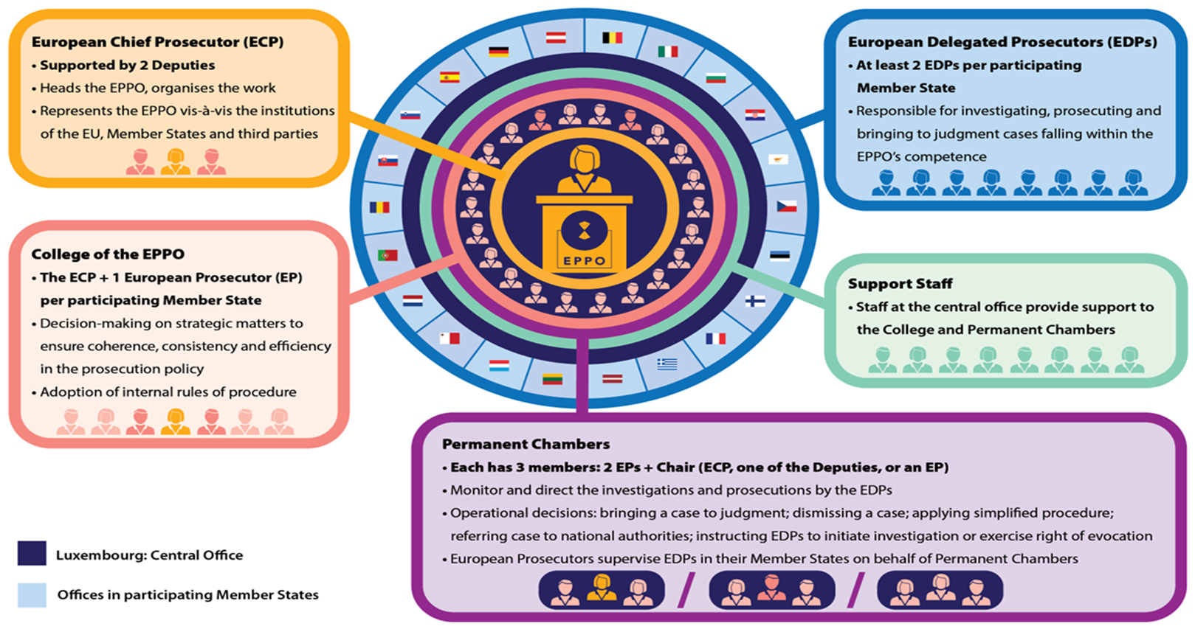

Slide 4
EPPO Competences
investigating, prosecuting and bringing to judgment perpetrators/accomplices to
criminal offences affecting the financial interests of the Union in Directive 2017/1371, as implemented by national law, (VAT fraud only cross border and over 10 million Euros) and under conditions also inextricably linked offences to these
participation in a criminal organization, if the focus of the criminal activity is to commit the offences in Directive 2017/1371

Slide 5
EPPO Competence
Shared with MS but with a right of evocation
EPPO exercises competence by
initiating an investigation or
using its right of evocation of case in hands of MS authorities

Slide 6
How does EPPO operate in MS?
EPPO single office
Conducts investigations in MS
through EDPs who are also national prosecutors (art. 17 par.2 ) acting on behalf of EPPO in MS (art.13 par.1 )

Slide 7
How does EPPO operate in MS?
EDPs follow instructions by the Permanent Chambers and supervising EPs on how to handle cases, e.g. which investigative measures to conduct
EDPs conduct the investigative measures on behalf of EPPO as national prosecutors of a MS under the conditions stated in that MS law (art.30)

Slide 8
Cross border investigations by EPPO
Handling EDP in one MS asks assisting EDP in the other MS to carry out the measure
Justification and adoption of measures by handling EDP according to the law of his MS
Enforcement of measure by assisting EDP according to Regulation and law of his MS

Slide 9
Judicial review in EPPO Regulation
By national courts in accordance with national law
of procedural acts of the EPPO /failures of the EPPO to adopt procedural acts that are intended to produce legal effects vis-à-vis third parties (Art. 42)
procedural acts taken in the performance of its functions of investigating, prosecuting or bringing to judgement (also choice of forum decisions at the latest at the trial stage)

Slide 10
Judicial review in EPPO Regulation
In order to ascertain whether an act produces such effects it is necessary to:
examine the substance of that act and
assess its effects in the light of objective criteria, such as its content, taking into account, as appropriate, the context in which it was made and the powers of the institution, body, office or agency that adopted it.

Slide 11
Judicial review in EPPO Regulation
By Court of Justice through preliminary rulings concerning:
(a) the validity of procedural acts of the EPPO, in so far as such a question of validity is raised before any court or tribunal of a Member State directly on the basis of Union law;
(b) the interpretation or the validity of provisions of Union law, including EPPO Regulation;
(c) the interpretation of Articles 22 and 25 of this Regulation in relation to any conflict of competence between the EPPO and the competent national authorities.

Slide 12
Judicial review in EPPO Regulation
By Court of Justice directly
the decisions of the EPPO to dismiss a case, in so far as they are contested directly on the basis of Union law,

Slide 13
Judicial review in EPPO Regulation
Apart from the cases that an EPPO act is judged by a last instance national court or by any national court if it considers there are grounds for its invalidity,
it lies within the discretion of national courts whether to refer the case to the CJEU for preliminary ruling.

Slide 14
Rule of law and judicial review
Rule of law (art.2 TEU)
The rule of law requires that all public powers act within the constraints set out by law, in accordance with the values of democracy and the respect for fundamental rights as stipulated in the Charter and other applicable instruments, and under the control of independent and impartial courts (Regulation 2020/2092).

Slide 15
Rule of law and judicial review
Rule of Law components
Judicial review as principle in Article 19 TEU requires MS to provide effective judicial protection in the fields covered by Union law
Effective judicial review as a right in art. 47 Charter

Slide 16
Effective judicial protection Art. 47 Charter
Effective judicial protection
Article 47 of the Charter corresponds to Articles 6 and 13 of the ECHR, it provides more extensive protection compared to the ECHR provisions .
After the entry into force of the Lisbon Treaty, the CJEU held that the principle of effective judicial protection, which it had developed as early as the 1980s, is affirmed in Article 47(1) of the Charter.
Article 47(1) of the Charter enshrines this right, while Article 19 TEU mandates the obligation for MS to establish a system of legal remedies ensuring effective judicial protection in areas of Union law

Slide 17
Effective judicial protection Art. 47 Charter
Effective judicial protection as a principle reinforces the correct application of Union law, while as a right, it requires another right arising from EU law to be protected before it can be activated
the institutional function of Article 19 TEU, from which the CJEU has inferred institutional guarantees (including independence) that national courts should fulfill in order to provide effective judicial protection C-64/16 - Associacao Sindical dos Juizes Portugueses Judgement.

Slide 18
Compatibility of judicial review of EPPO acts with art. 47 Charter
Can national courts through the preliminary ruling procedures stipulated in Art. 42 (2) EPPO Regulation effectively review the EPPO decisions?
CJEU Stan v. EPPO
Declared inadmissible action against Decision by Permanent Chamber to bring the case to judgement brought directly before CJEU
Rejected recourse to a broad interpretation of Art. 42 allowing for direct judicial review by CJEU because it was not compatible with the wording of the provision at issue
“and that even the principle of interpretation in conformity with a rule of superior binding force cannot serve as the basis for an interpretation that is contra legem (par. 30)”.

Slide 19
Judicial review in cross border investigations
CJEU Judgment of G.K. and others 21. 12. 2023 –
C-281/22
“the review conducted in the MS of the assisting European Delegated Prosecutor, where an assigned investigation measure requires judicial authorisation in accordance with the law of that Member State, may relate only to matters concerning the enforcement of that measure, to the exclusion of matters concerning the justification and adoption of that measure; the latter matters must be subject to prior judicial review in the Member State of the handling European Delegated Prosecutor”

Slide 20
Judicial review of EPPO acts
CJEU, Judgement 8.4.2025 - C-292/23
whether a decision of a European Delegated Prosecutor to summon a witness to appear is intended to produce binding legal effects capable of affecting the rights of the persons who are the subject of an investigation by bringing about a distinct change in their legal position.

Slide 21
Judicial review of EPPO acts
CJEU Judgement 8.4.2025 - C-292/23
it is for the competent national courts to assess, having regard, inter alia, to national procedural rules, as well as to the specific context of the criminal investigation with which they are concerned, whether a decision of a European Delegated Prosecutor summoning a witness to appear is intended to produce binding legal effects capable of affecting the interests of the persons challenging that decision, such as, in the present case, the persons who are the subject of that investigation, by bringing about a distinct change in their legal position, inter alia by affecting their procedural rights.

Slide 22
EPPO’s position in national legal order
substantial level of integration of EPPO within the MS’s systems of criminal procedure in the context within which they exercise their competences is the reason for the national courts having jurisdiction in respect of EPPO acts (C-292/23).

