Slide 1

The EU's rule of law toolbox
Athens, 5 September 2025
Professor Laurent Pech
Notes:
The EU's Rule of Law Toolbox
Session 1: Overview of the EU's preventive and response tools
Session 2: Selected examples regarding the use, misuse and non-use of the toolbox
Includes Mock Group Problem Question?
To include examples where the rule of law tools have been used/not used to protect fundamental rights.

Slide 2

Outline
Part 1: Background
I.1 The rule of law and other EU values in the EU Treaty Framework
I.2 Rule of law and democratic backsliding: Definitions and situation in the EU
Part II: The EU’s Rule of Law Toolbox
II.1 Promotion/Prevention Tools
II.2 Response/Enforcement Tools
Part III: The EU’s Rule of Law Toolbox in Practice
III.1 Promotion and preventive tools in practice (by date of adoption)
III.2 Response and enforcement tools in practice (by date of adoption)

Slide 3
Part I: Background i.1 the rule of law and other EU values in the EU Treaty Framework

Slide 4
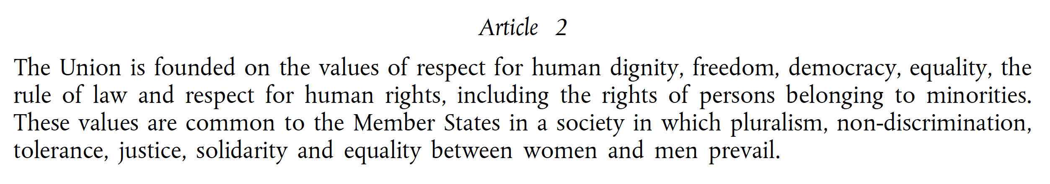
Key treaty provision aimed at current EU member states (Art 2 TEU)
Notes:
See also Article 7 TEU

Slide 5
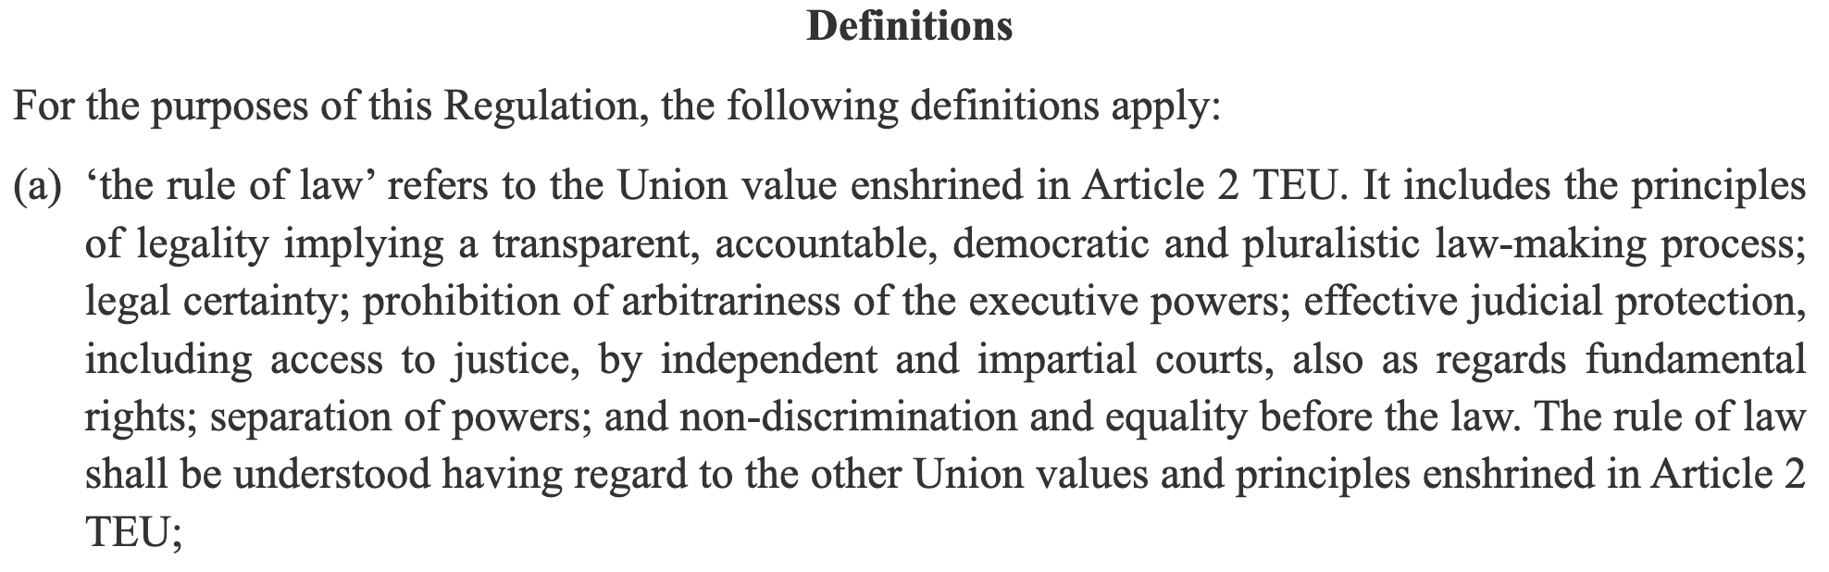
Meaning and scope of the rule of law

Slide 6
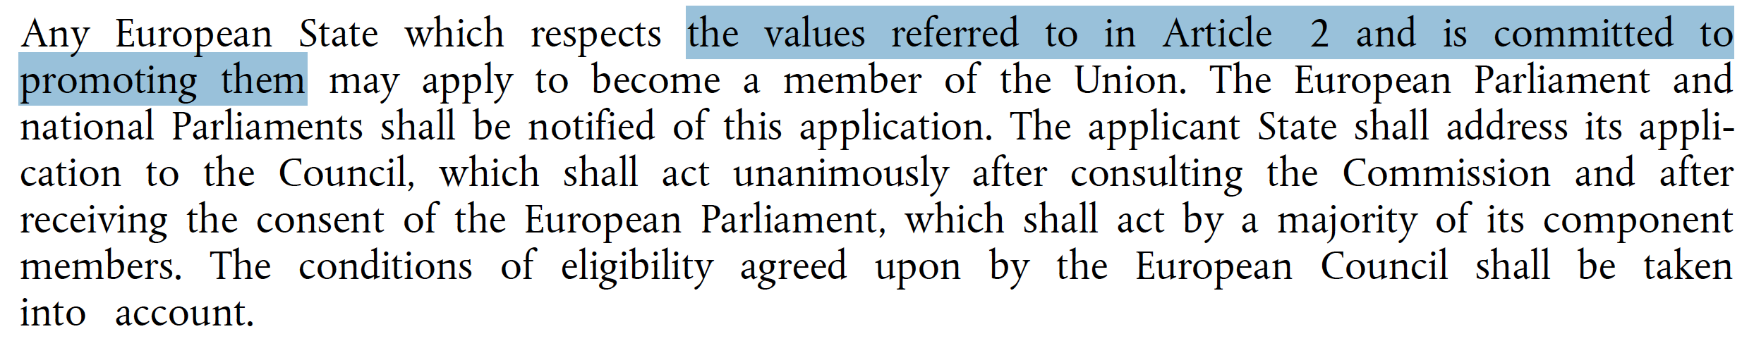
Key Treaty provision aimed at prospective EU member states:
Article 49 TEU

Slide 7
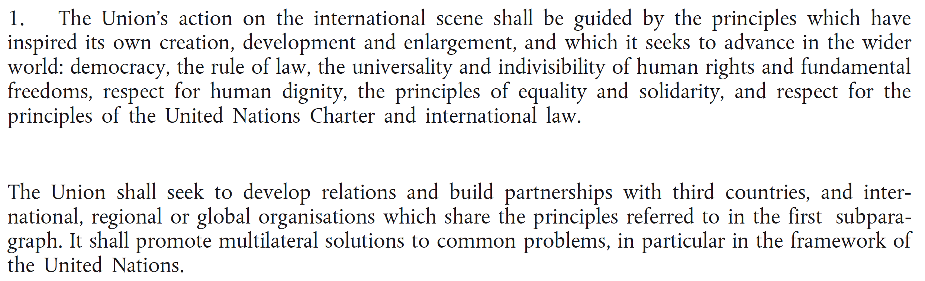
Key Treaty provision aimed at Third Countries & IOs: Article 21 TEU
Notes:
NB: Para 2 refers to the need to (i) SAFEGUARD Art 2 values + (ii) CONSOLIDATE & (iii) SUPPORT democracy, the rule of law, human rights and the principles of international law

Slide 8
Rule of law and other Article 2 TEU values as mere open-ended, non-binding policy guidelines?
ECJ in 2022 in Cases C-156/21 and C-157/21:
Article 2 TEU “is not merely a statement of policy guidelines or intentions, but contains values” which “are given concrete expression in principles containing legally binding obligations for the Member States.”
Orban’s Minister of Justice in 2019: The rule of law is a “buzzword” lacking “well-defined rules”
&
HU/PL governments in 2021: All Art 2 TEU values are open-ended political values

Slide 9
ECJ in C-156/21 and C-157/21 re the rule of law specifically
Hungary and Poland “cannot maintain that the Member States are not in a position to determine with sufficient precision the essential content and the requirements flowing from each of the principles listed in Article 2(a) of the contested regulation [2020/2092] nor that those principles are of a purely political nature and that an assessment of whether they have been respected cannot be the subject of a strictly legal analysis.”

Slide 10
Does the EU have the power to defend Art 2 TEU values?
ECJ in C-156/21 and C-157/21 :
“The values contained in Article 2 TEU have been identified and are shared by the Member States.
They define the very identity of the European Union as a common legal order.
Thus, the European Union must be able to defend those values, within the limits of its powers as laid down by the Treaties”

Slide 11
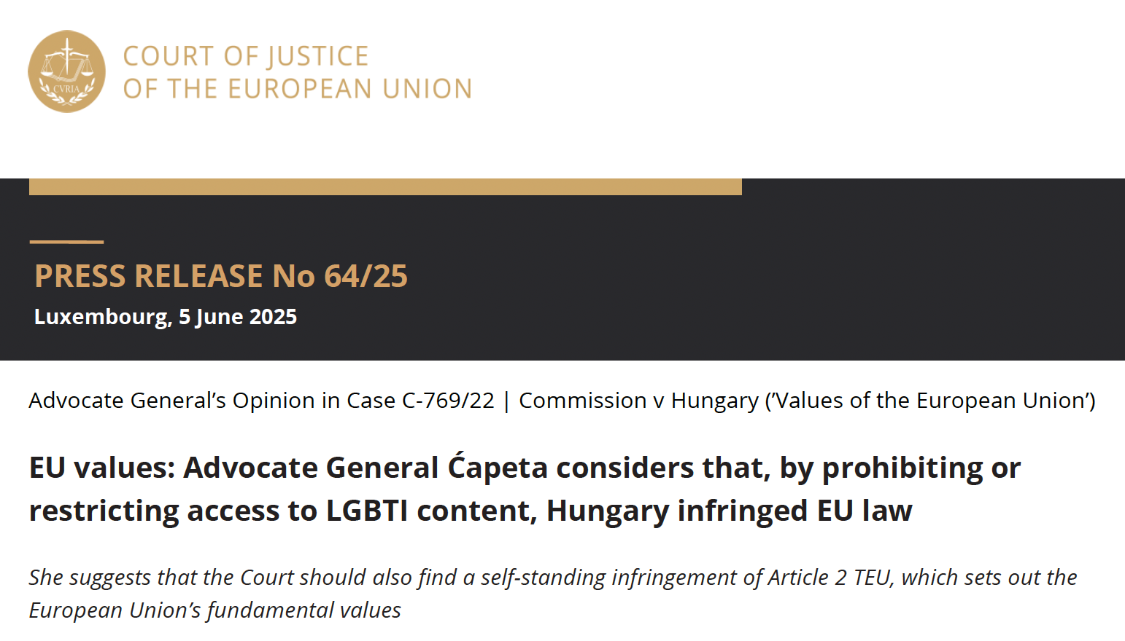
CJEU’s potential next answer to the systemic violation of art 2 values: Case C-769/22

Slide 12
1.2 Democratic and Rule of Law backsliding: Definitions and situation in the EU

Slide 13
Rule of Law Backsliding: Definition
The process through which
elected public authorities deliberately implement governmental blueprints which
aim to systematically weaken, annihilate or capture internal checks on power with
the view of dismantling the liberal democratic state and entrenching the long-term rule of the dominant party
Pech and Scheppele, ‘Illiberalism Within: Rule of Law Backsliding in the EU’
Cambridge Yearbook of European Legal Studies (2017)

Slide 14
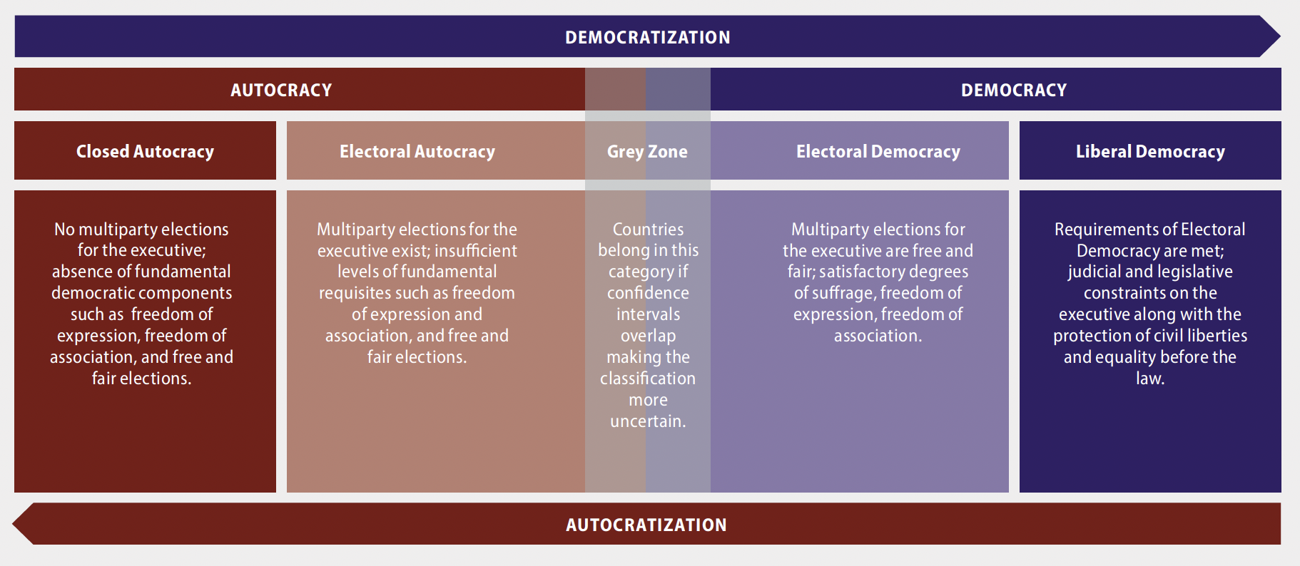
Rule of law backsliding + democratic backsliding = from democracy to autocracy
Notes:
Source: VDEM

Slide 15
Post Lisbon treaty unexpected “rule of law backsliding/crisis”
CJEU President Koen Lenaerts, 2021: “it is no exaggeration to say that its foundations as a Union based on the rule of law are under threat and that the very survival of the European project in its current form is at stake”
ECtHR President Síofra O’Leary, 2023: “As evidenced by ... instances of democratic erosion in transitional and previously stable democracies, rule of law backsliding, or signs of regression when it comes to issues such as equality … some of the fundamental values enshrined in the Convention are under threat in different parts of Europe and beyond”

Slide 16
European Parliament resolution of 19 May 2022 on the Commission’s 2021 Rule of Law Report
“whereas without concrete recommendations and effective follow-up, the rule of law report may fail to prevent, detect and address effectively and in a timely manner systemic challenges and backsliding on the rule of law, as witnessed in several EU Member States in recent years”

Slide 17
Advocate General Ćapeta (Opinion of 5 June 2025 in case C-769/22)
184. The rule of law crisis, resulting in a number of judgments of the Court, taught us that values should not be taken for granted. Member States must actively work not only at maintaining the level of existing protection at the point of entry into the European Union, but must also take the necessary measures to remove any existing obstacles impeding the full respect of those values in their societies.

Slide 18
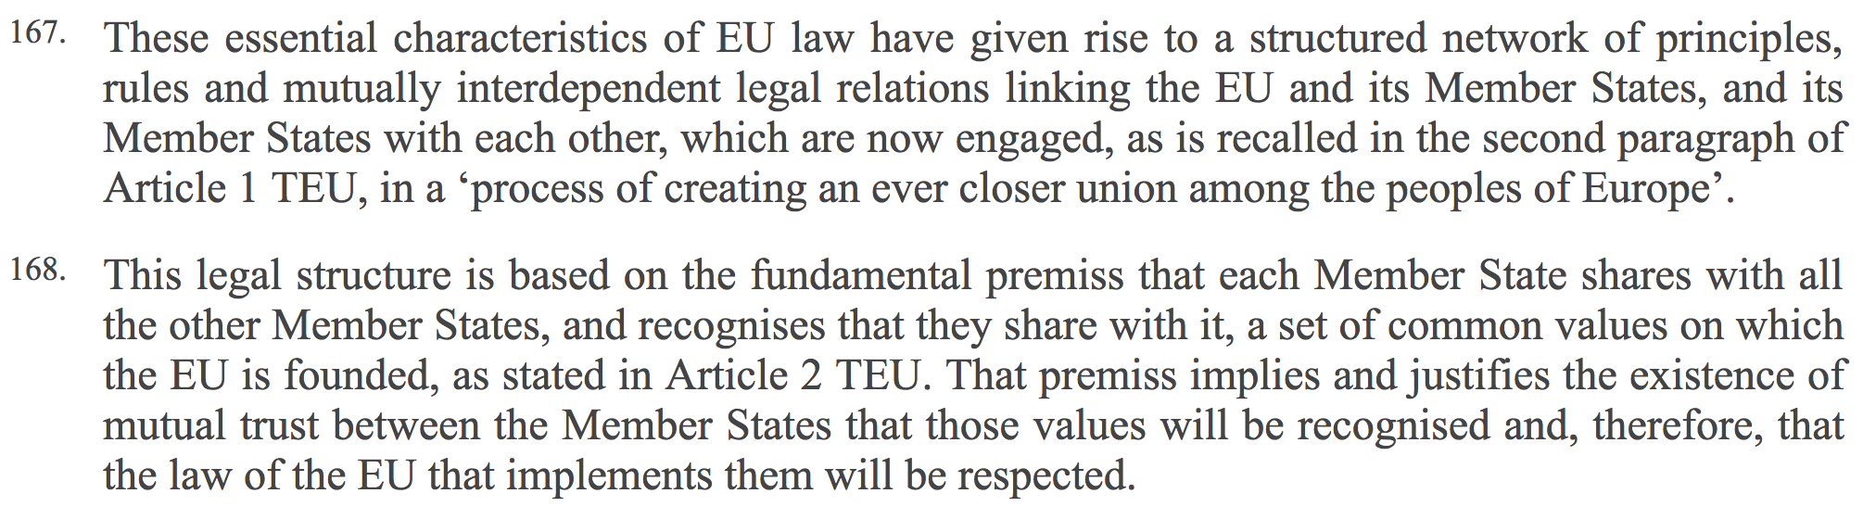
rule of law backsliding as An existential threat for the EU’s legal order

Slide 19
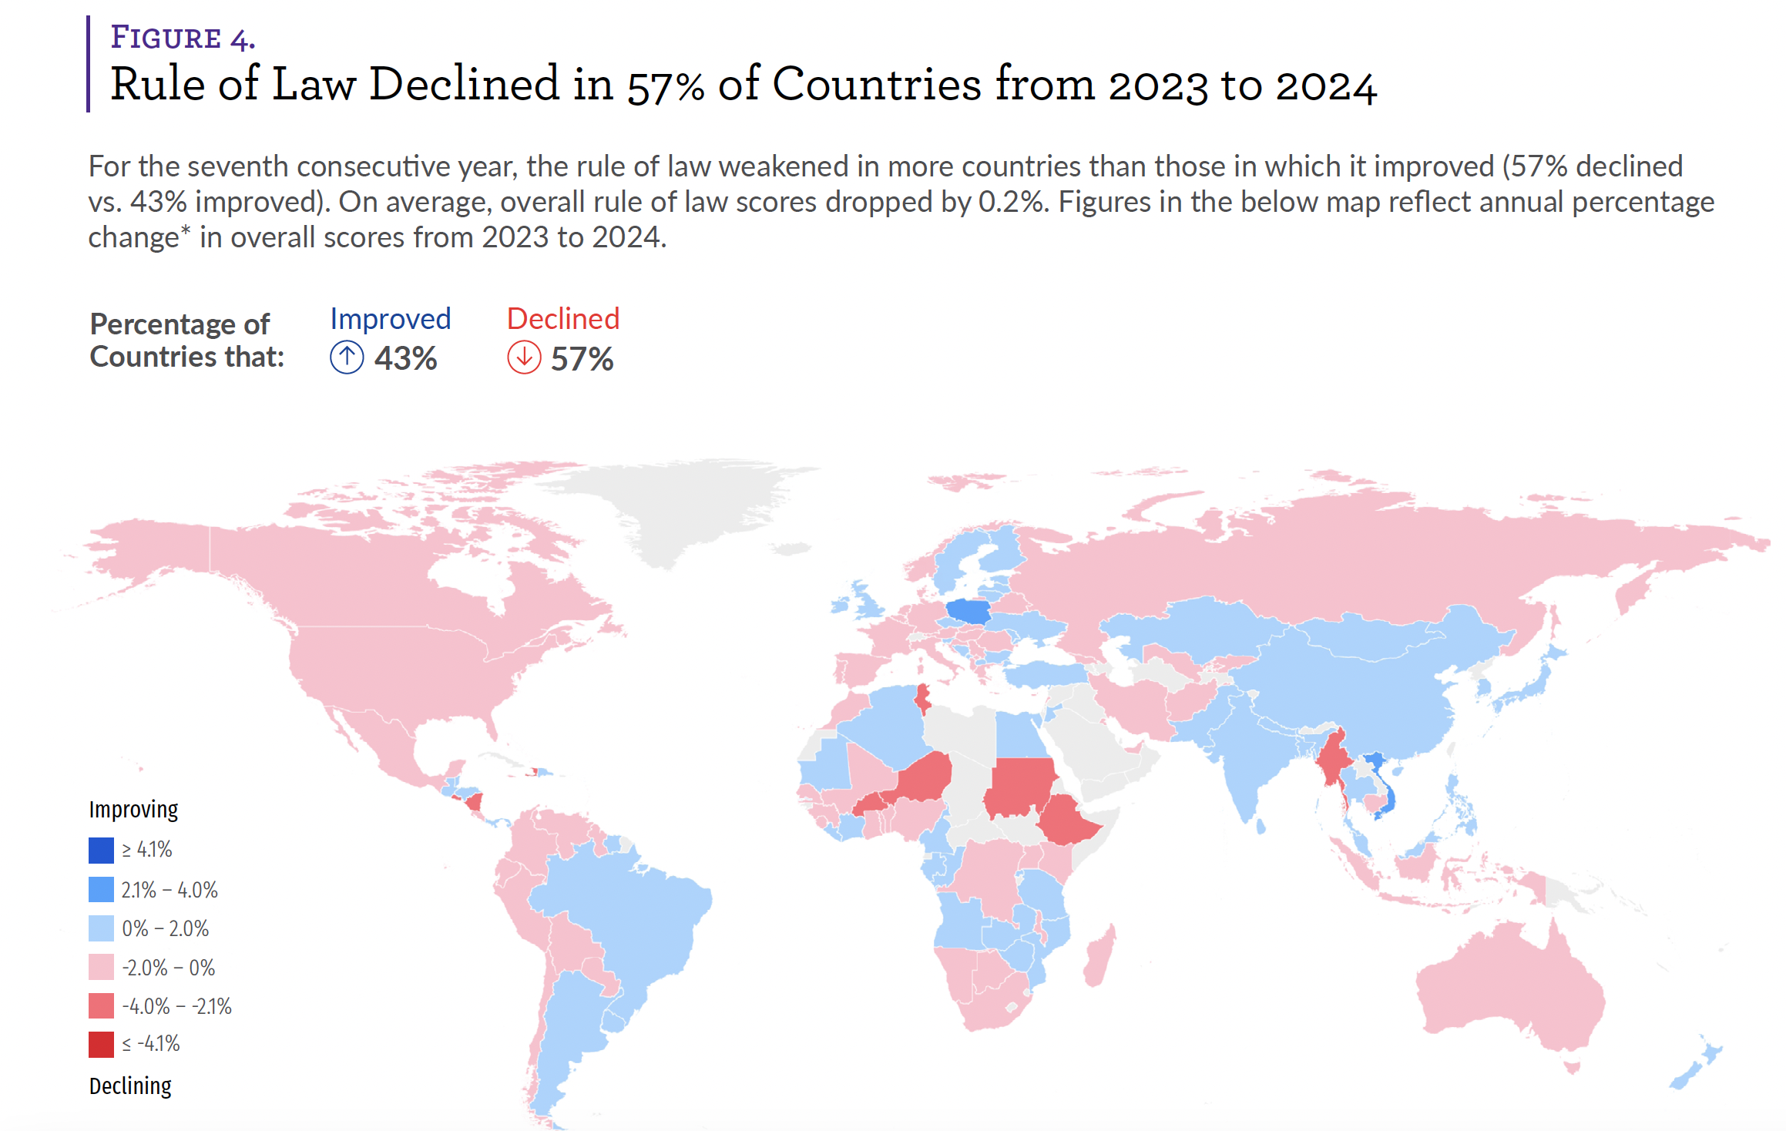
A global trend
“Since 2016, a global rule of law recession has affected 77% of countries studied”
Notes:
https://worldjusticeproject.org/rule-of-law-index/insights
https://worldjusticeproject.org/rule-of-law-index/country/2024
Since 2016, a global rule of law recession has affected 77% of countries studied.
Globally, the declines were largely driven by authoritarian trends. Between 2016 and 2024, the Index factor measuring Fundamental Rights fell in 81% of countries.
Over the past seven years, Index scores for Constraints on Government Powers have fallen in 77% of countries. Around the world, legislatures, judiciaries, and civil society—including the media—have all lost ground on checking executive power, the Index shows.

Slide 20
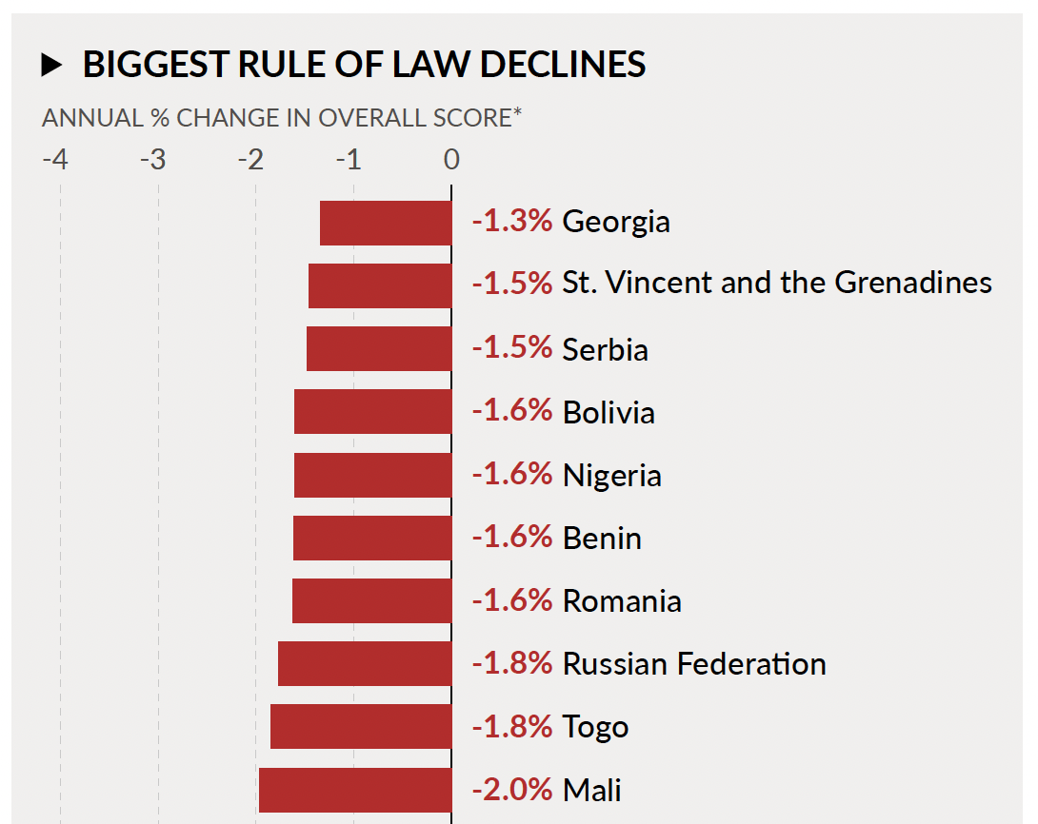
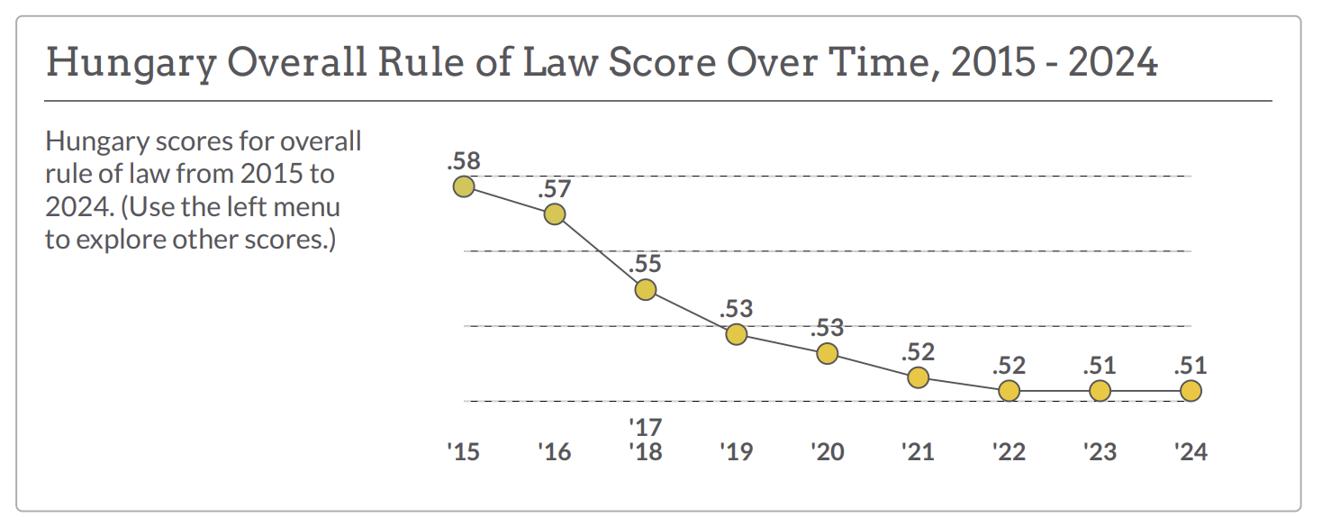
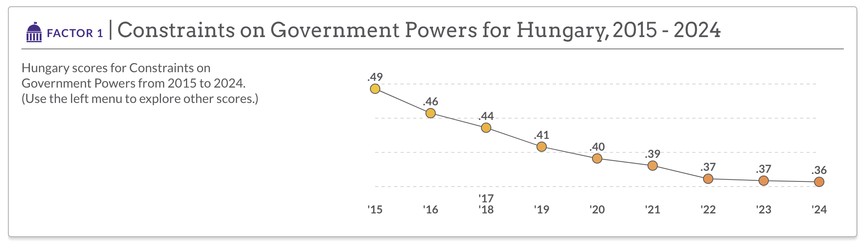
“Biggest” annual roL declines v sustained rol declines:
Example of hungary
(latter more significant than former + not all rol indicators are relevant to detect autocratisation)

Slide 21
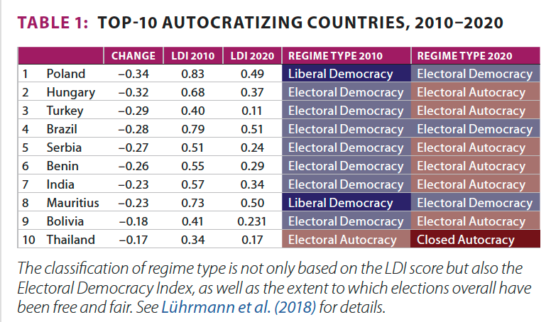
Democratic backsliding aka Autocratisation in the EU since 2010

Slide 22
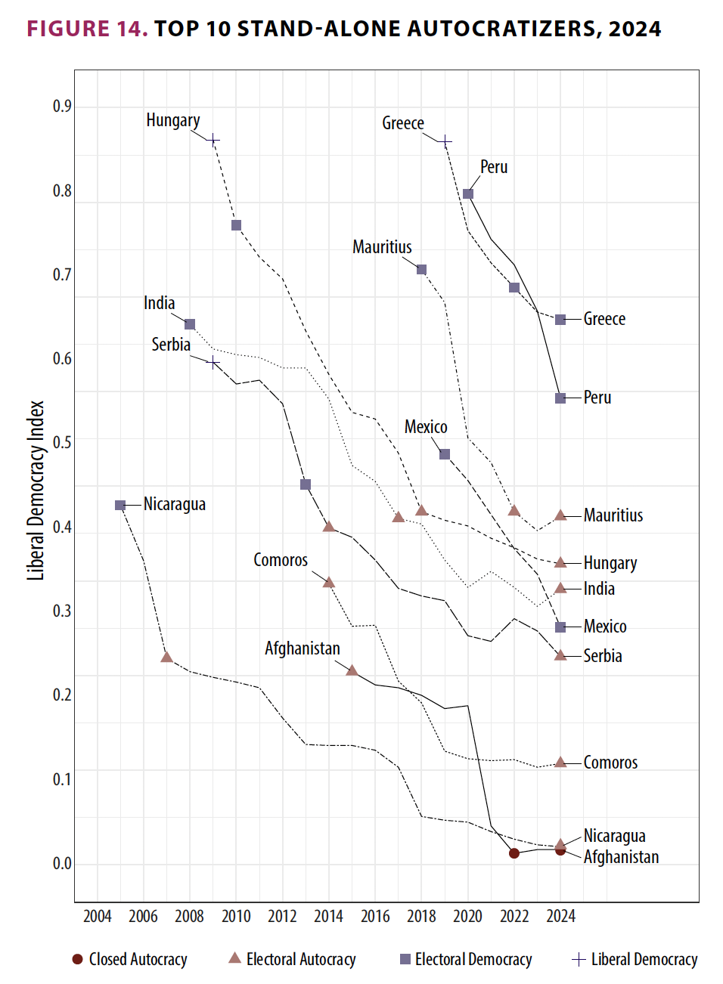
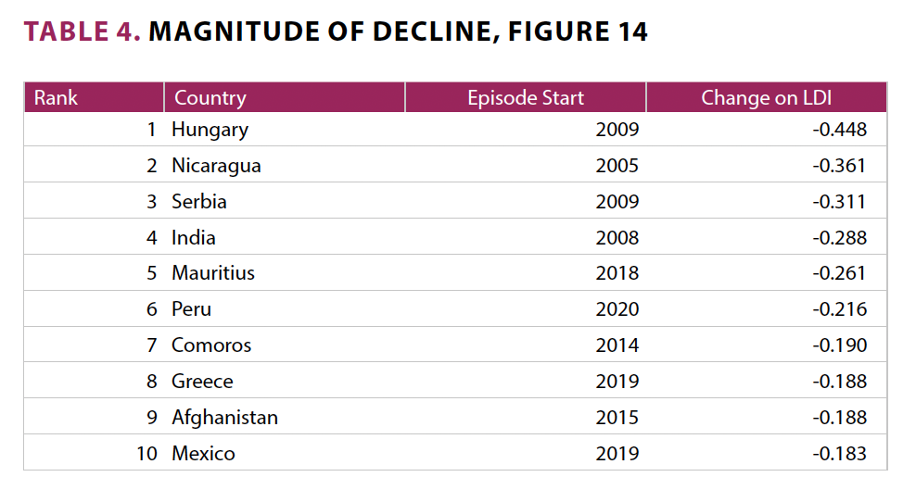
VDEM 2025: “Autocratization is also manifest within the [EU], affecting Greece, Hungary, and Romania.”
Notes:
Key point: Rule of law backsliding is usually followed by democratic backsliding which explains why same EUMS can be identified as backsliding/autocratising countries on both accounts
Compare to Factor 1 or overall WJP scores for Hungary, Serbia and Greece to see if they match WJP trends
Romania on next slide

Slide 23
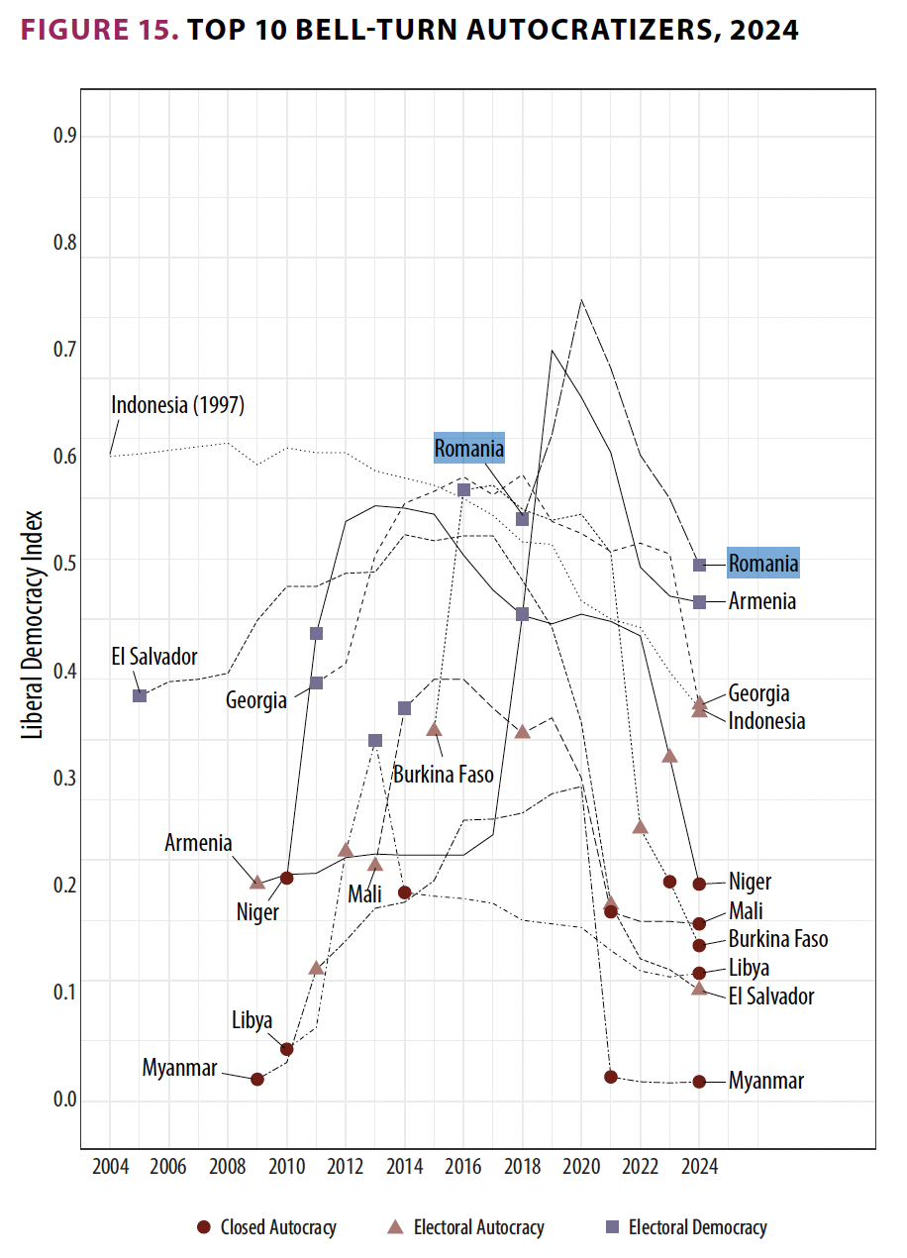
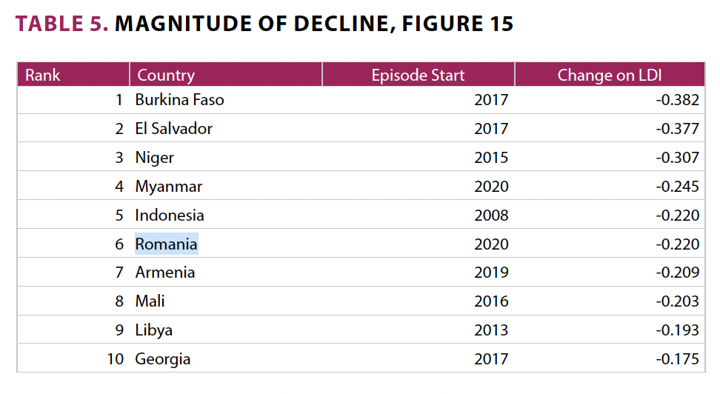
VDEM 2025: Romania as a “bell-turn” case
(i.e. where autocratization follows shortly after, and is connected to, a period of democratization)
Notes:
VDEM 2025: Bell-turns can be thought of as episodes of “failed democratization”, or re-autocratization shortly after a period of substantial improvement. 90% of the ongoing Bell-turn cases were democracies at some point during the episode. Yet, all but two of these ongoing processes have already led to breakdown of democracy. Only Armenia and Romania remain democracies, but their current trajectories suggest that democracy may be at risk.

Slide 24
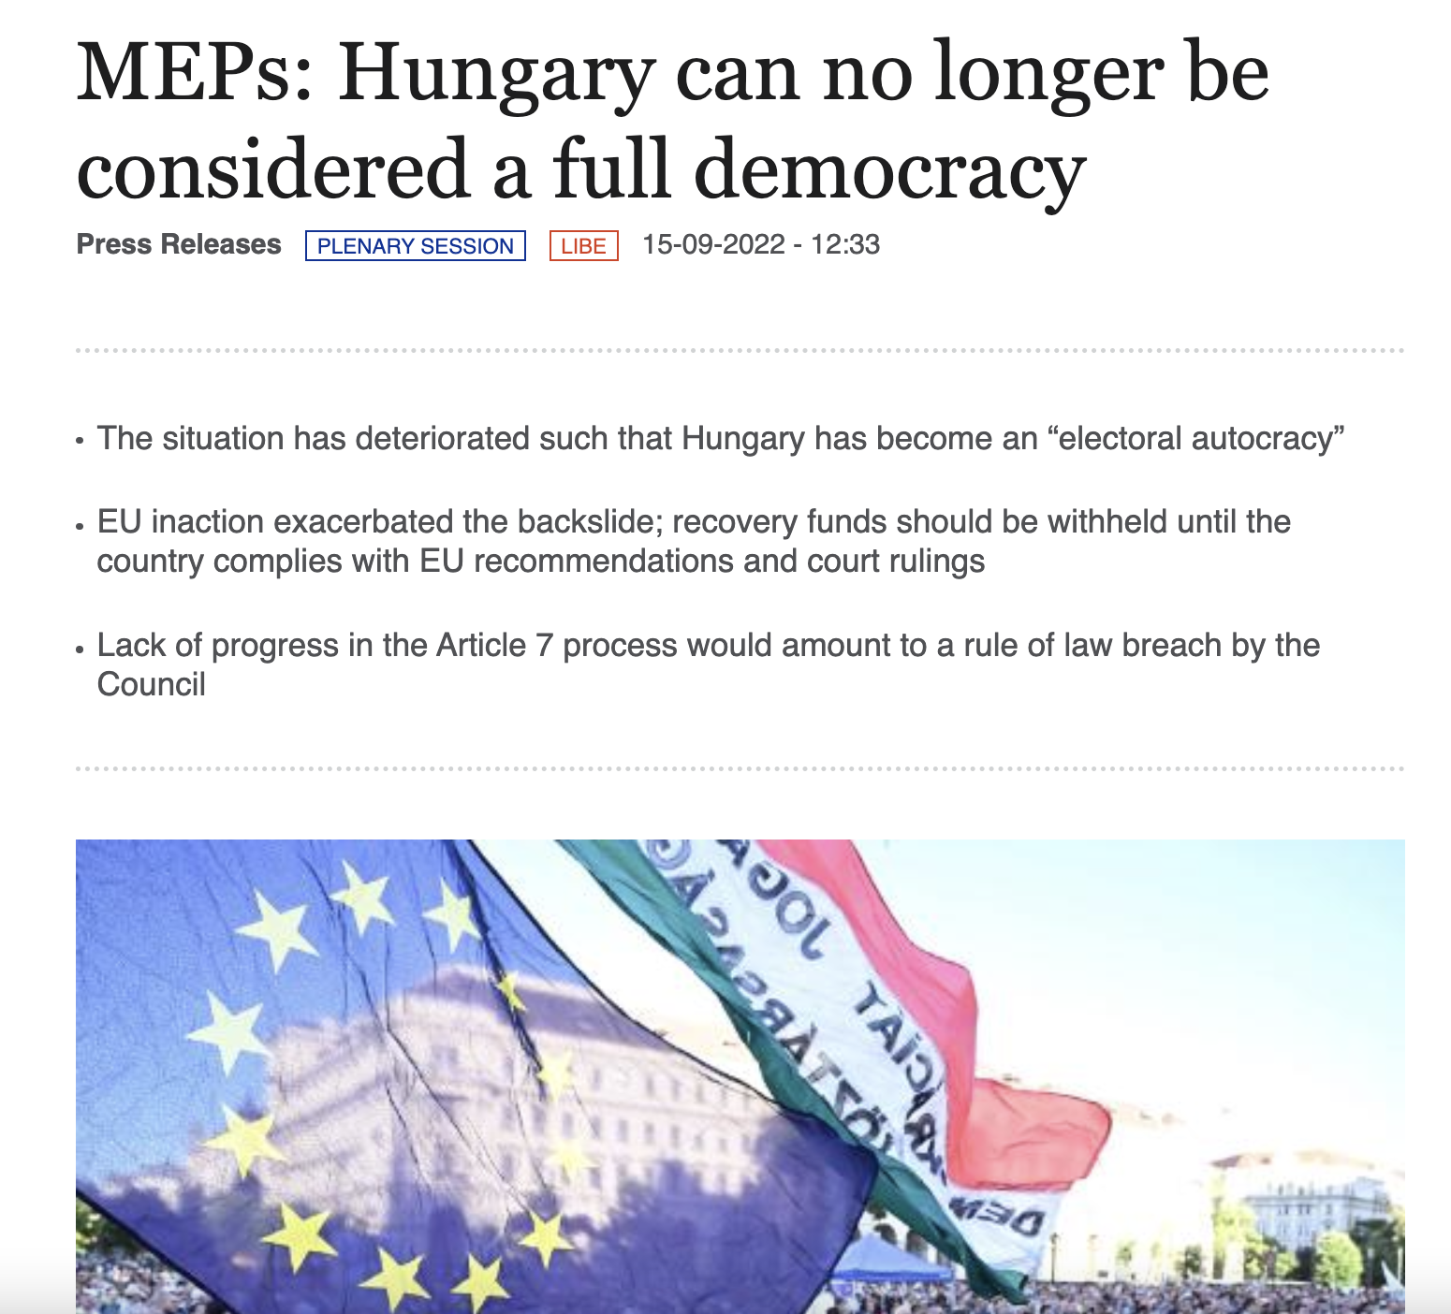
No longer in denial: The European parliament’s resolution of sept 2022 on Hungary
Unprecedented diagnosis in September 2022 by the EP:
First ever formal recognition by one of the EU Institutions that one of the EUMS is no longer a democracy
Consequences: None to date

Slide 25
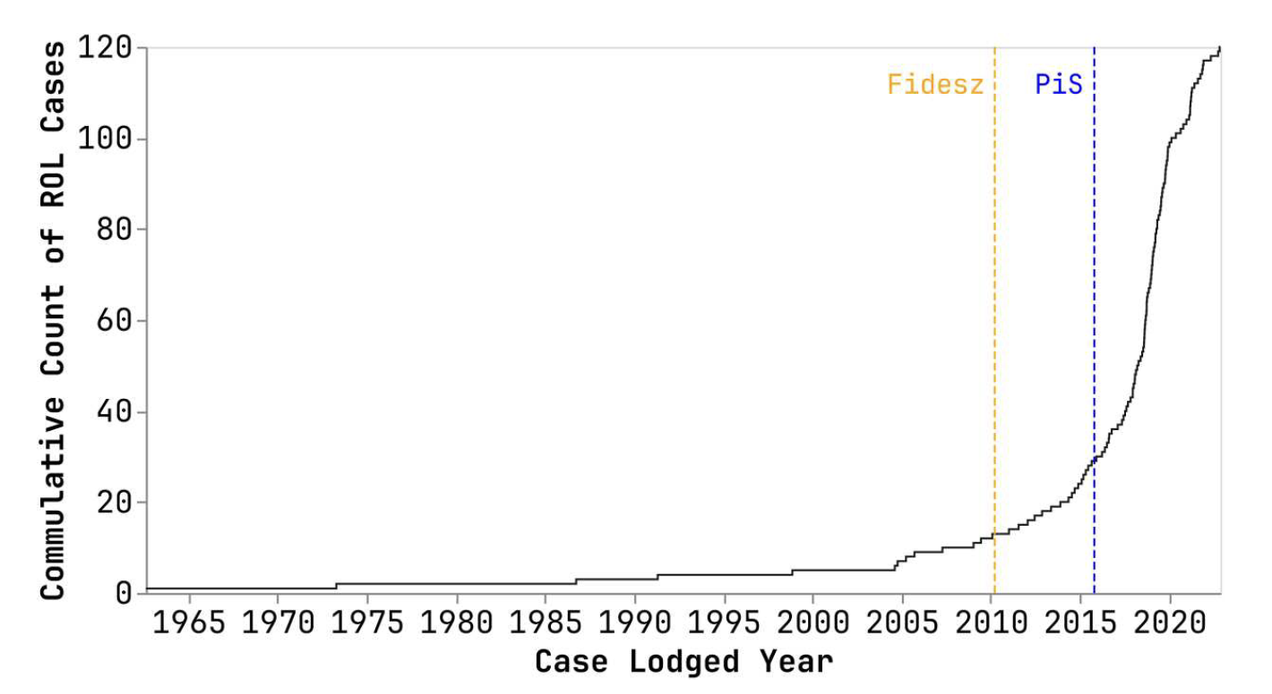
Quantitative Impact of rule of law backsliding on CJEU rule of law case law
Notes:
Source: https://www.tandfonline.com/doi/full/10.1080/13501763.2024.2336125

Slide 26
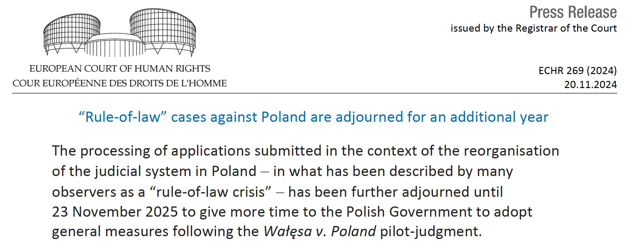
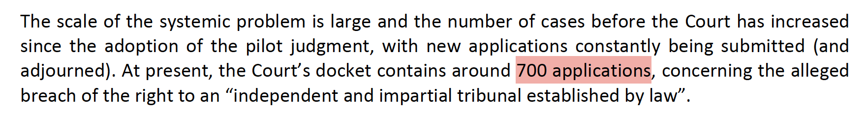
Quantitative Impact of rule of law backsliding on ECtHR rule of law case law

Slide 27
Latest development: increasing non-compliance with EU law and national/european rulings
European Parliament in 2024:
“Notes that the proper enforcement of all EU law is the very precondition for a union based on the rule of law; condemns the sometimes open and unashamed non-compliance of several Member States with EU law in various fields, such as the right to effective judicial protection, anti-corruption laws, asylum, the implementation of sanctions, and human rights law; underlines that this risks making the EU an area where some Member States feel more equal than others and citizens’ EU rights and freedoms are not evenly protected
Notes:
https://www.europarl.europa.eu/doceo/document/TA-9-2024-0108_EN.html

Slide 28
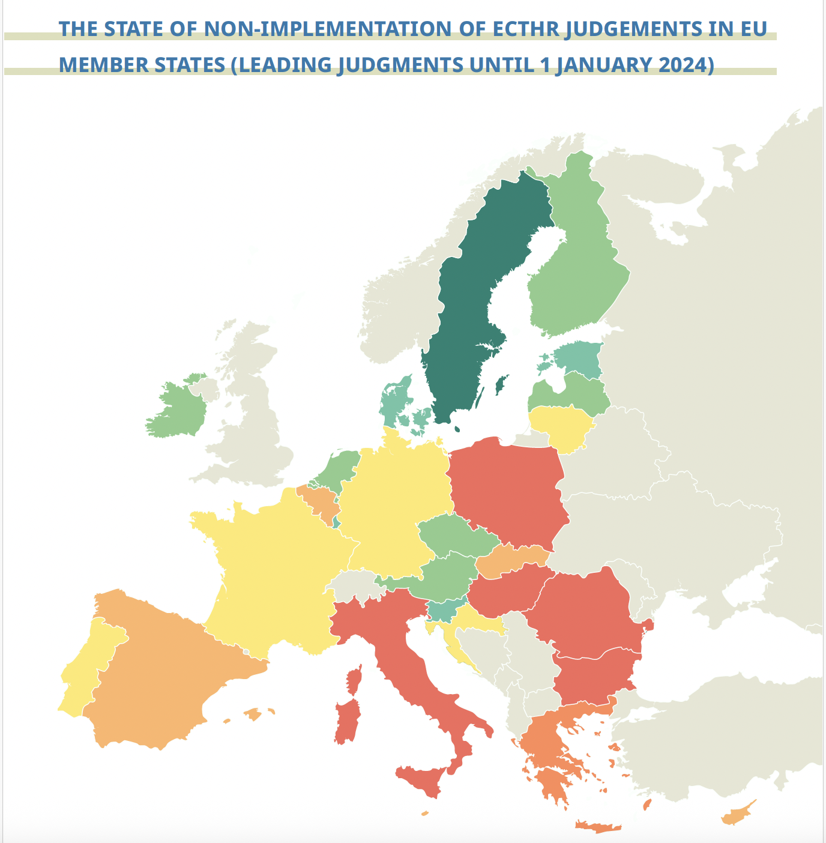
Non-compliance with ECtHR judgments in the EU
See annual study by the European Implementation Network (EIN) and Democracy Reporting International (DRI)

Slide 29
Part II the EU’s rule of law toolbox

Slide 30
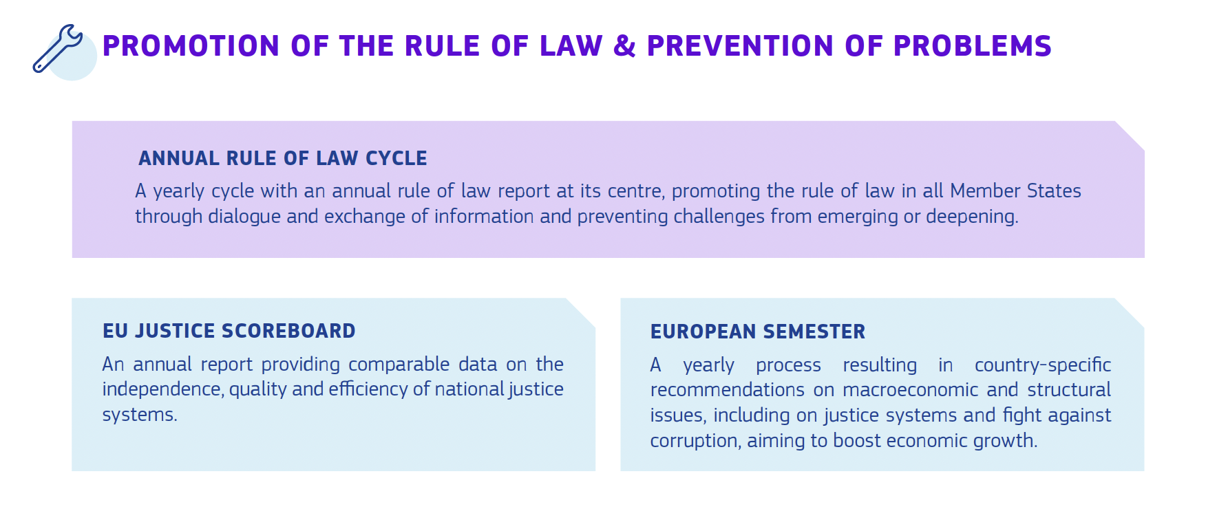
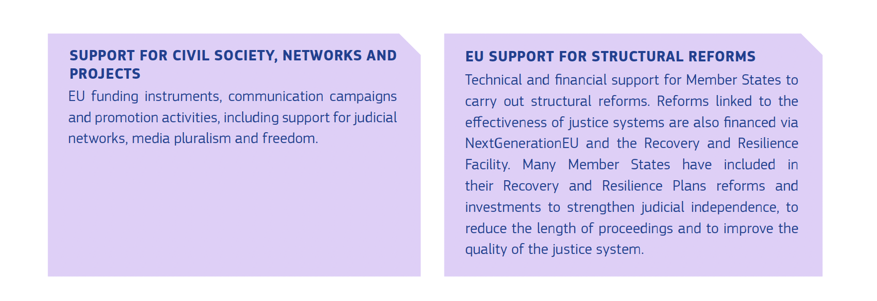
Notes:
https://commission.europa.eu/strategy-and-policy/policies/justice-and-fundamental-rights/upholding-rule-law/rule-law/annual-rule-law-cycle/2025-rule-law-report_en

Slide 31
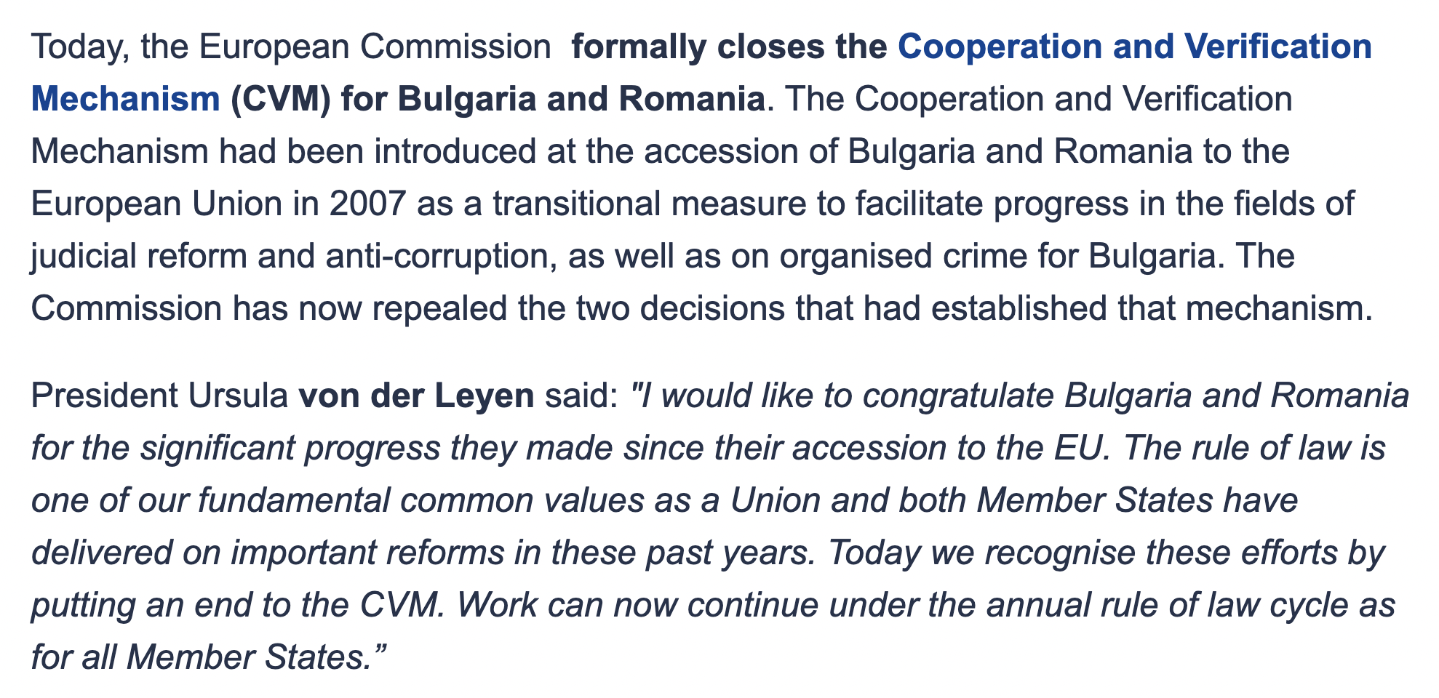
Repealed prevention mechanism in sept 2023: CVM
Notes:
https://ec.europa.eu/commission/presscorner/detail/da/ip_23_4456

Slide 32
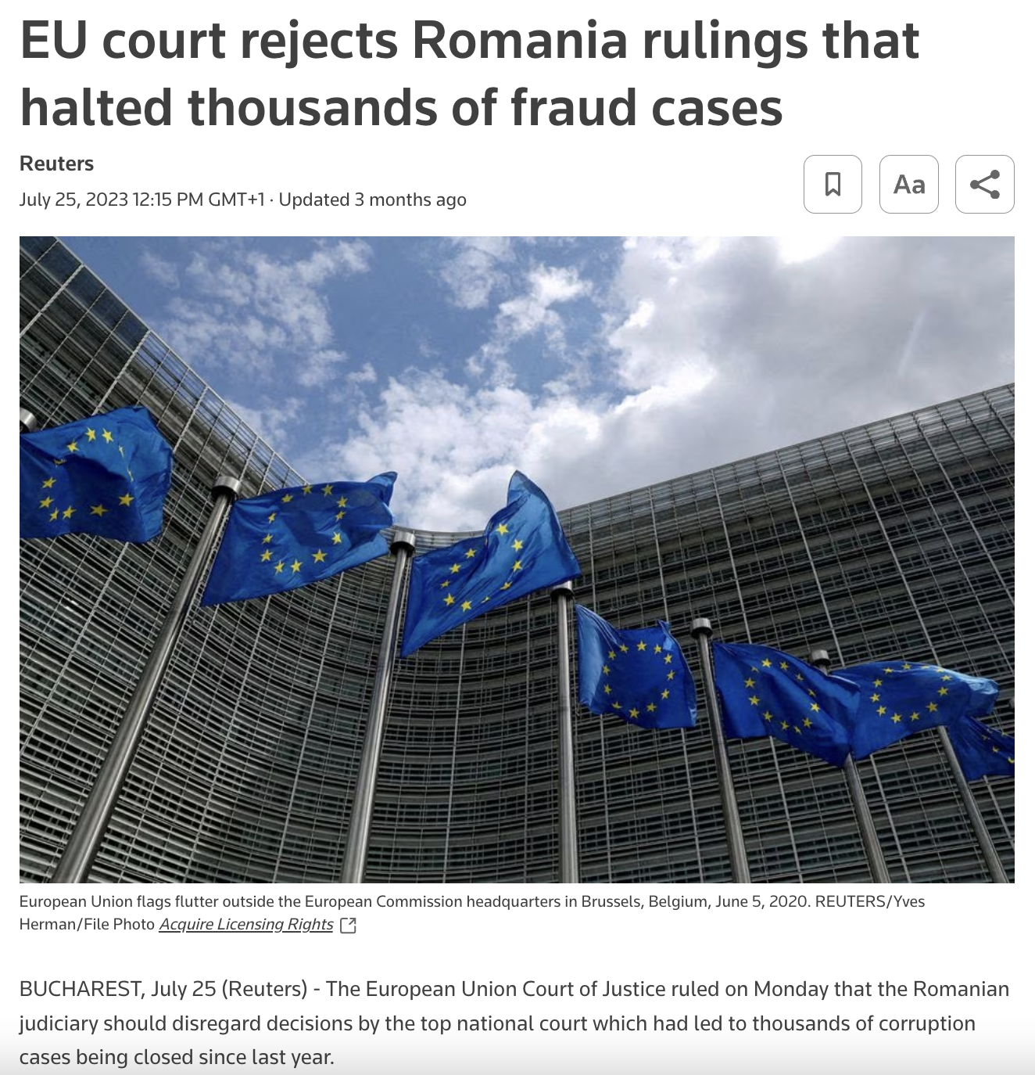
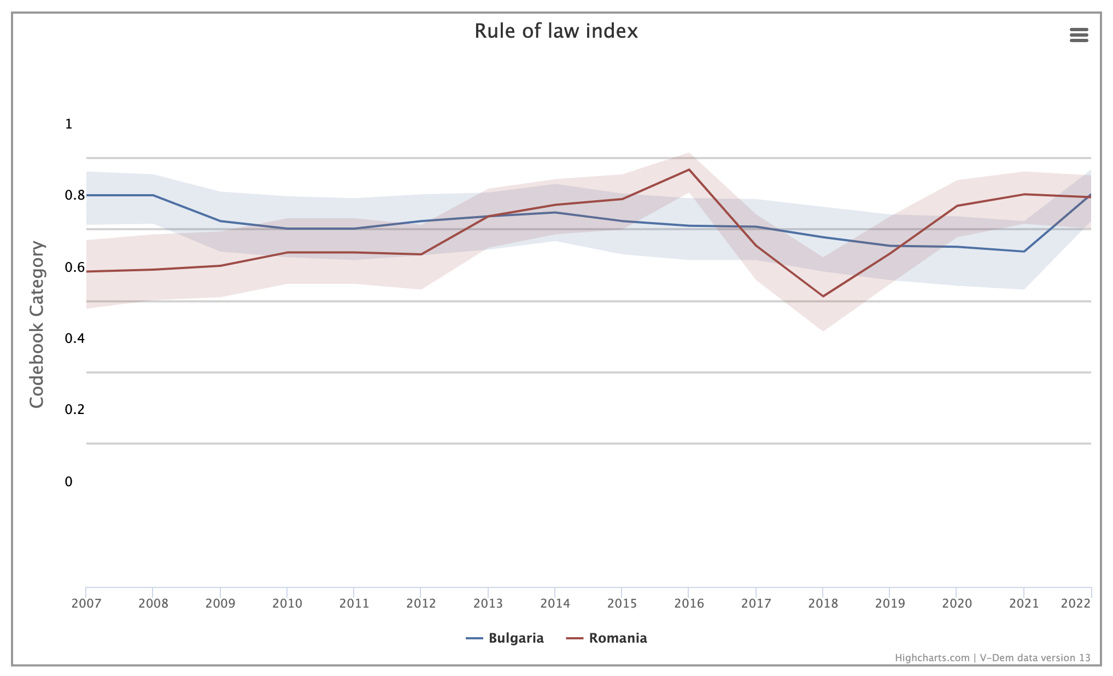
“significant progress” since “their EU Accession: A quick reality check
Notes:
https://v-dem.net/data_analysis/VariableGraph/

Slide 33
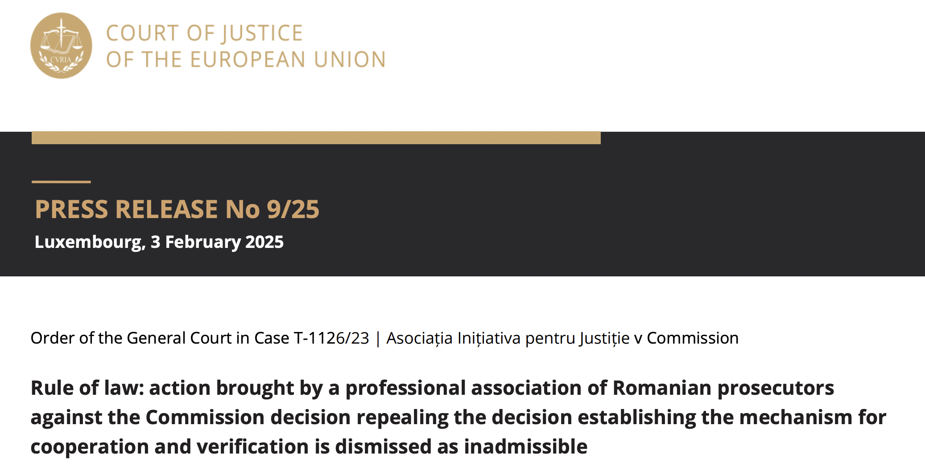
Challenging arguably arbitrary and irregular repeal of a preventive rule of law
Notes:
https://curia.europa.eu/jcms/upload/docs/application/pdf/2025-02/cp250009en.pdf

Slide 34
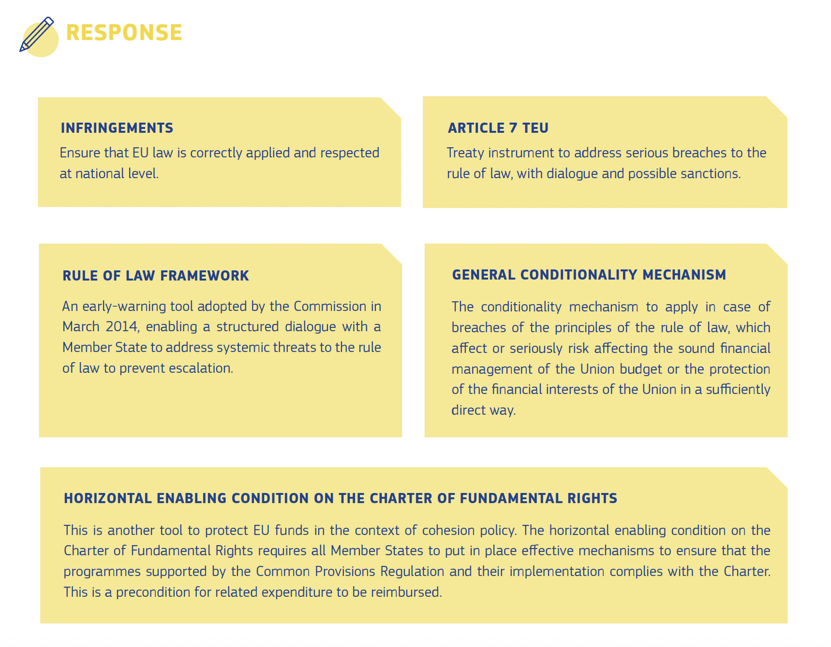

Slide 35
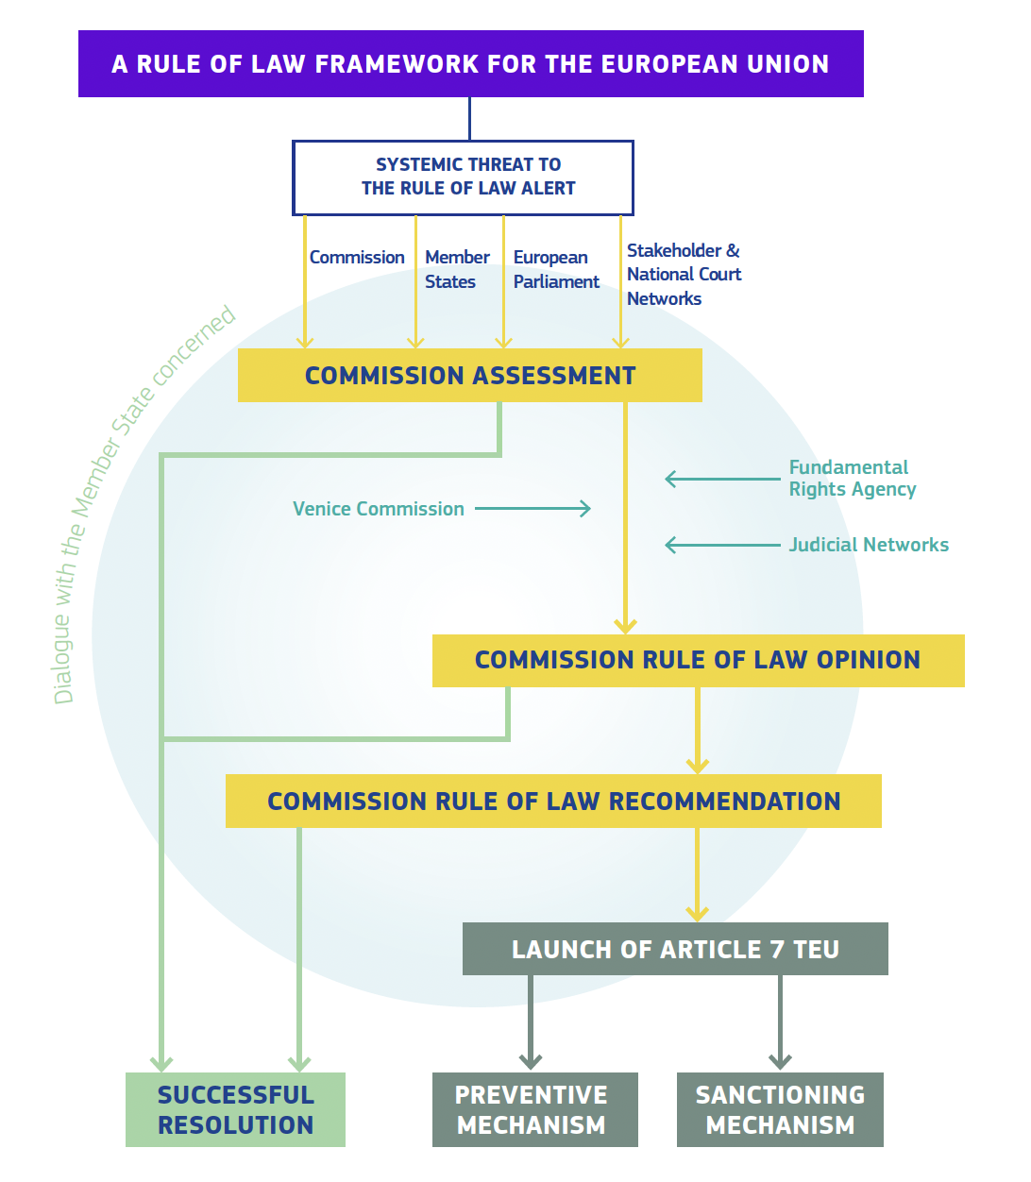
Misrepresented tool In the commission’s overview of the EU's toolbox: the rule of law framework (”pre-article 7” tool) as a preventive rather than a response tool

Slide 36
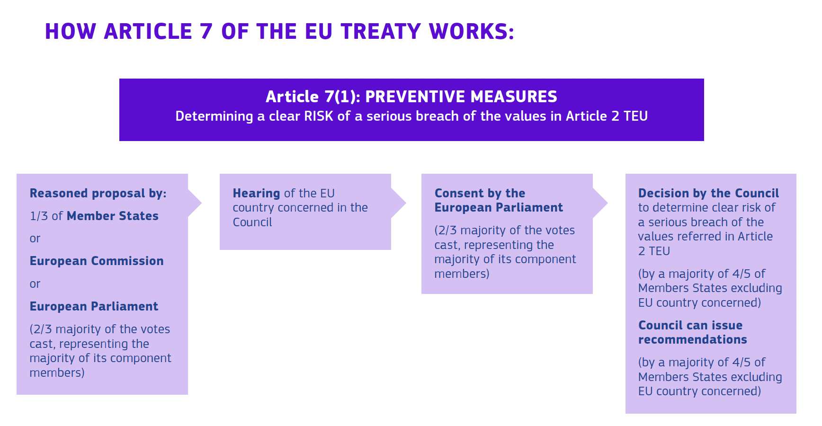
Misrepresented tool In the commission’s overview of the EU's toolbox: preventive arm of article 7 TEU

Slide 37
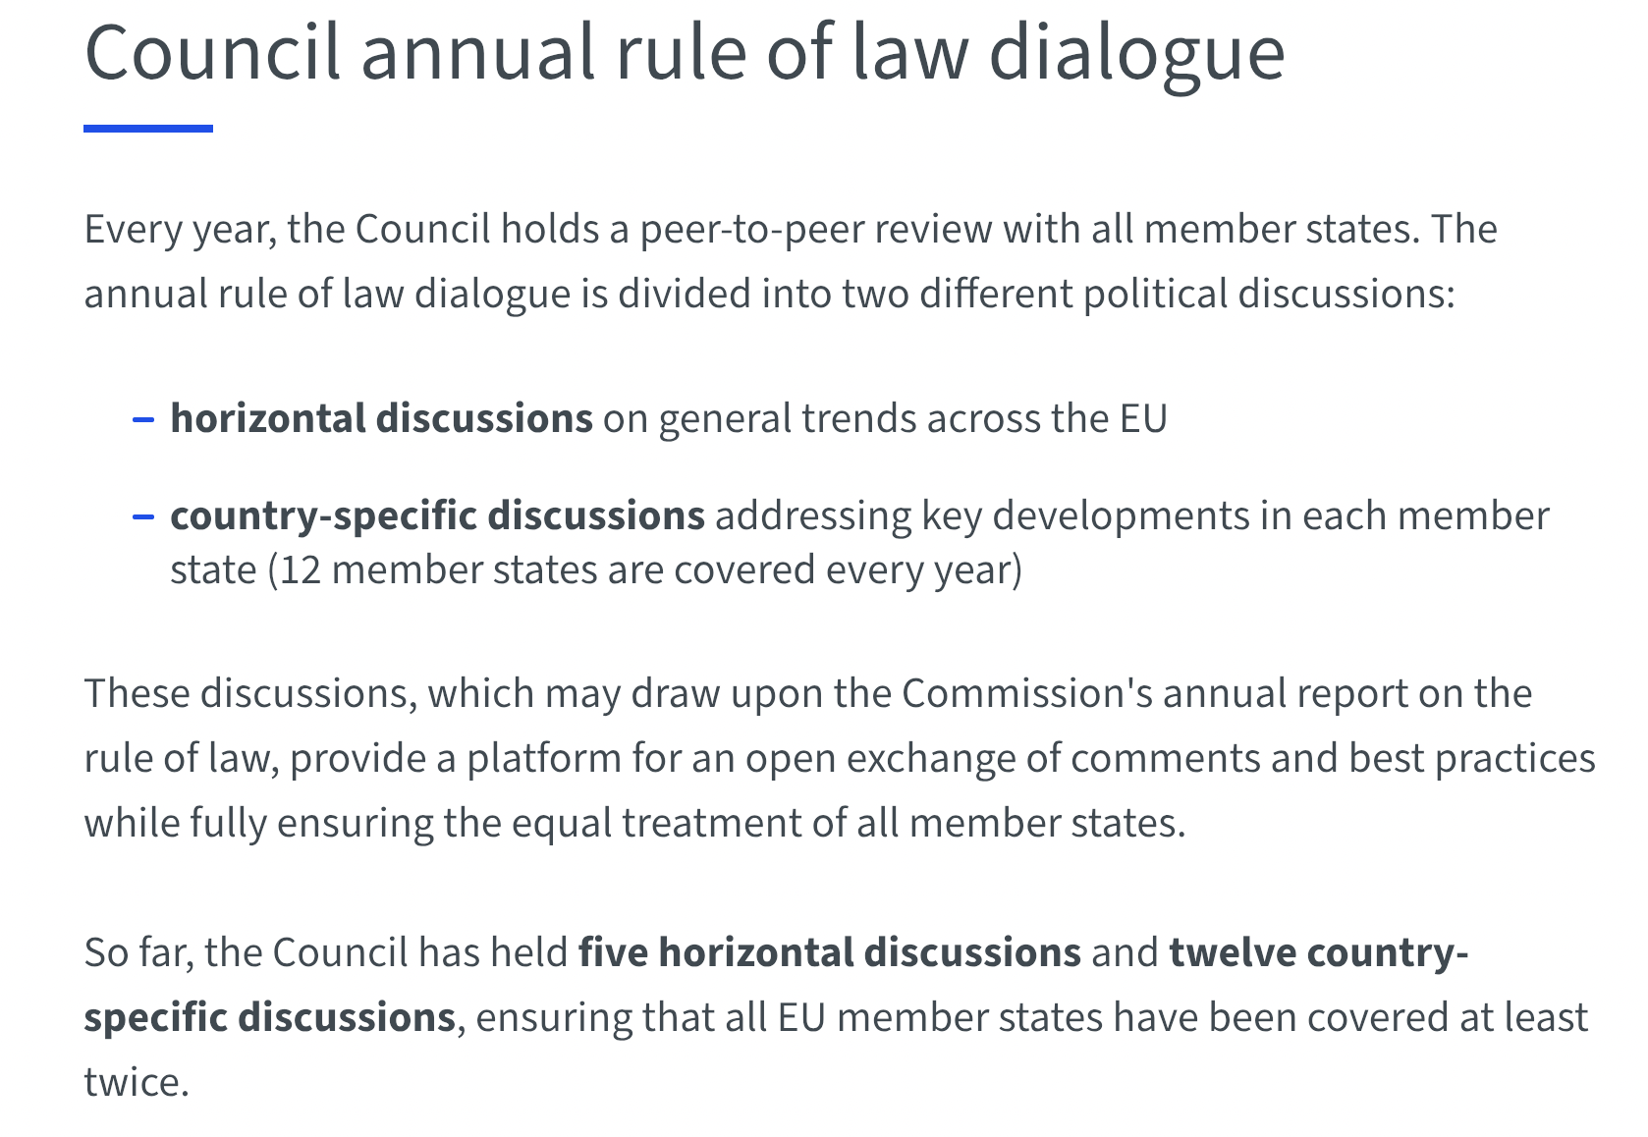
Missing (preventive) tool from the commission’s overview of the EU’s the council’s role of law dialogue
Notes:
https://www.consilium.europa.eu/en/topics/rule-of-law/

Slide 38
Missing (response) tool from the commission’s overview of the EU's rule of law toolbox:
Article 267 TFEU
References for preliminary rulings are a keystone of the EU’s legal system.
With national courts applying EU law directly, this procedure allows them to check with the Court of Justice how national laws should be interpreted before ruling on a case.
Discover more about how this procedure works and the dialogue that is created between national courts and the CJEU: https://www.youtube.com/watch?v=Ffr368m58QI
Notes:
https://www.youtube.com/@CourtofJusticeEU

Slide 39
Part III the EU’s rule of law toolbox in practice
(presented by date of adoption/ entry into force)

Slide 40
III.1 the promotion and preventive tools in practice
Notes:
NB: Presented by date of adoption and not date of first use

Slide 41
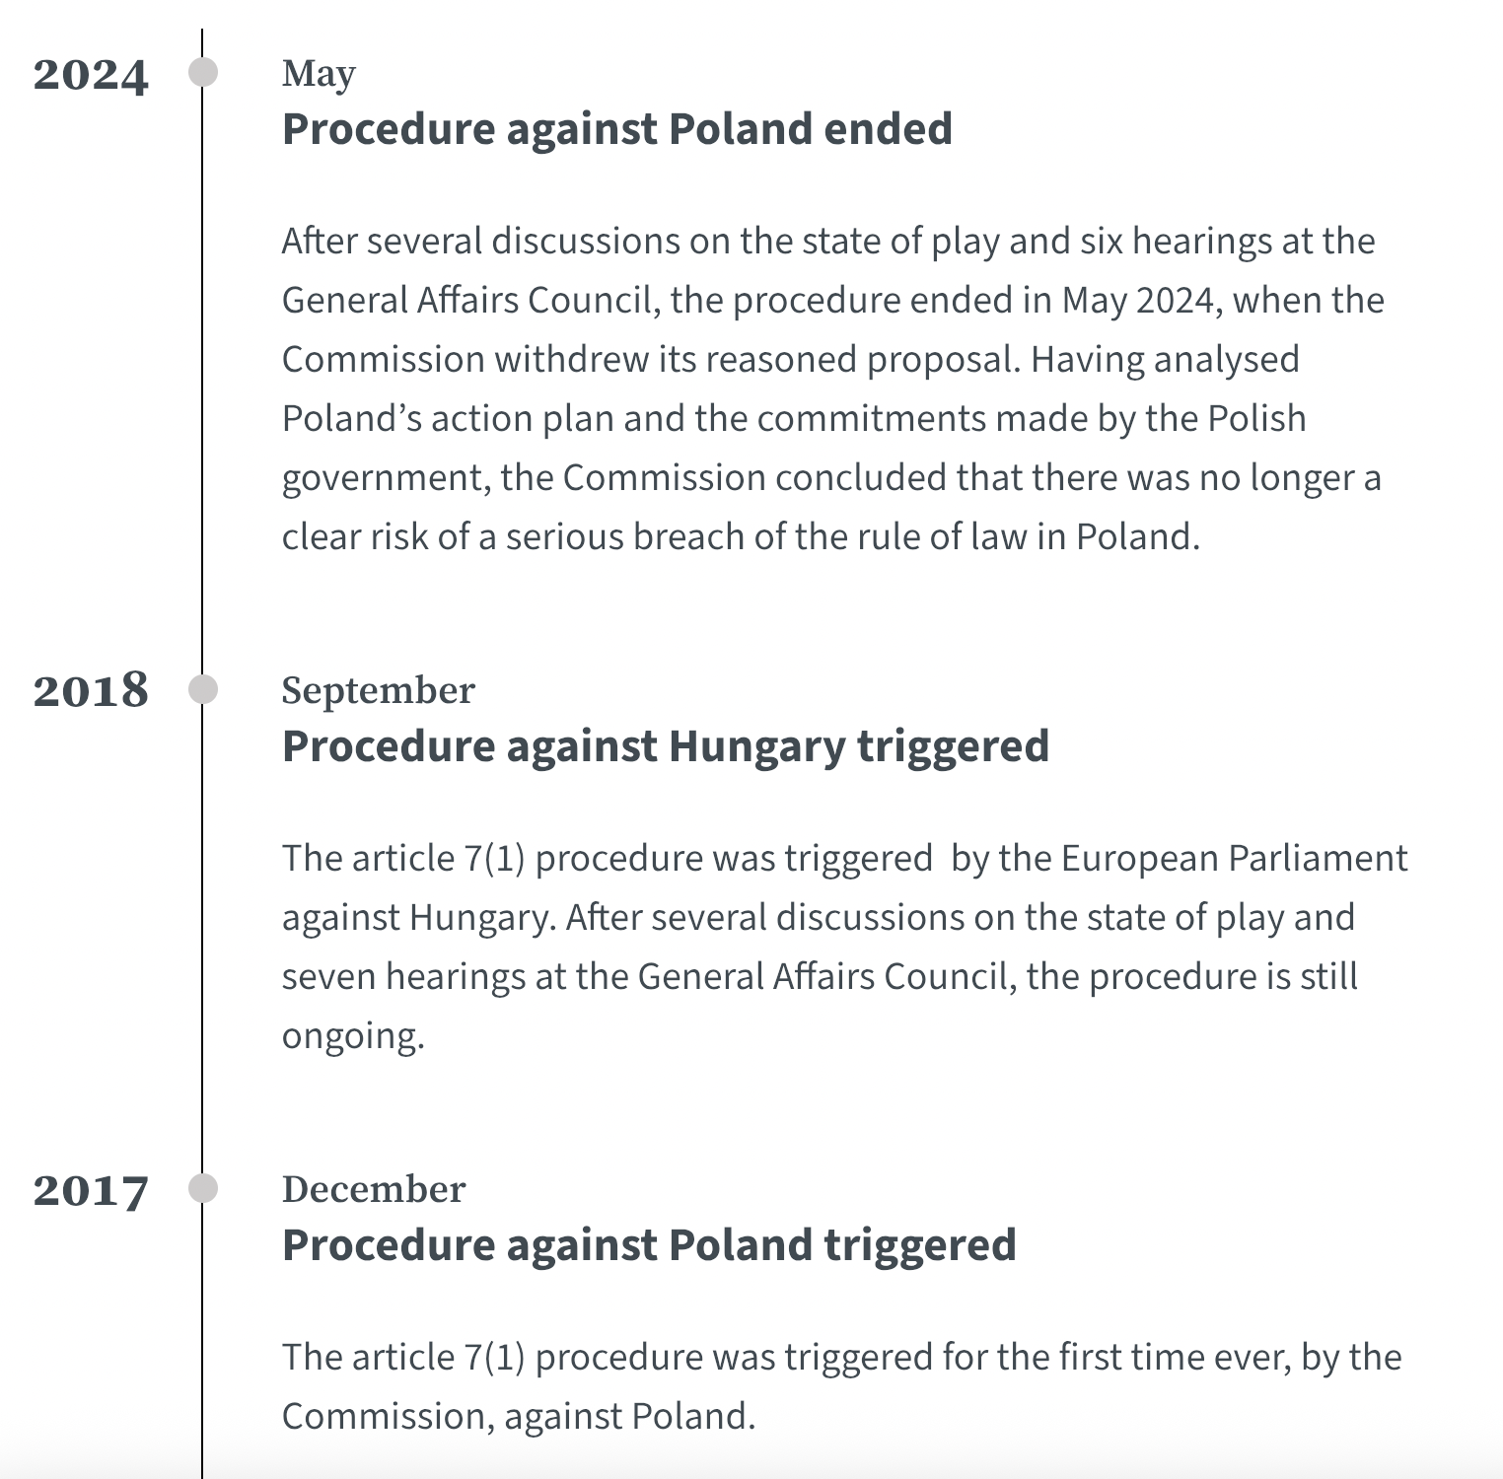
Preventive arm
of Article 7 TEU
(2003)
Notes:
https://www.consilium.europa.eu/en/policies/article-7-procedures/timeline-the-story-of-article-7/

Slide 42
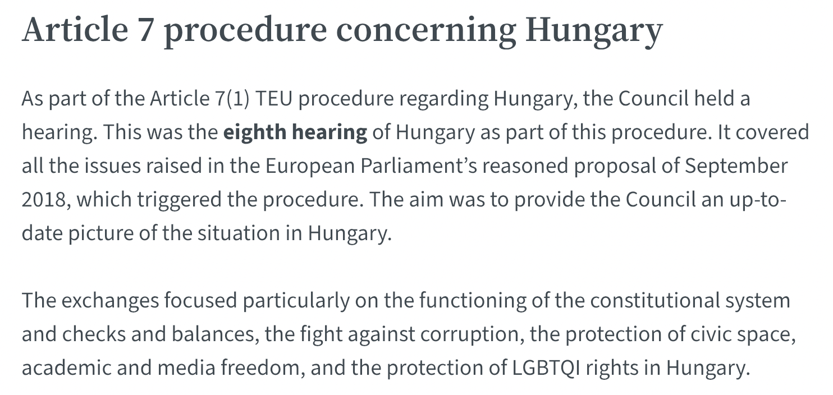
Preventive arm of Article 7 TEU (2003): Latest
Notes:
https://www.consilium.europa.eu/en/meetings/gac/2025/05/27/

Slide 43
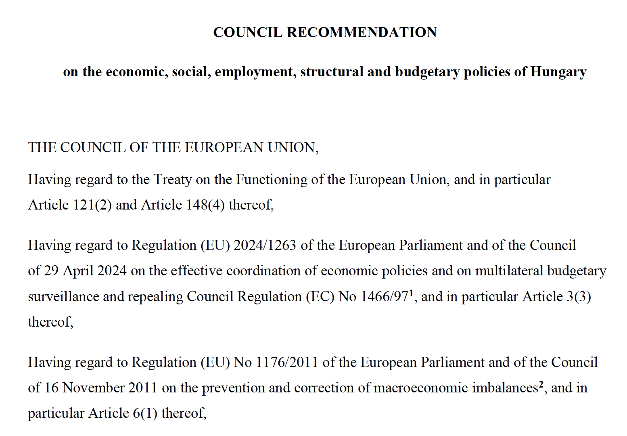
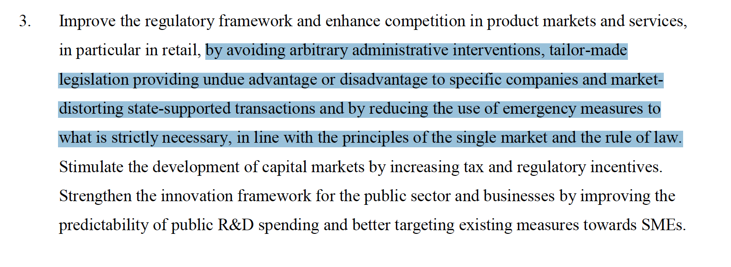
European semester (2010)
Notes:
Reminder: The Commission published its first annual Justice Scoreboard in 2013 and connected this new instrument to the ‘European Semester’, the EU process of economic policy coordination it introduced in 2010, with the Justice Scoreboard primarily justified on business/economic grounds
The legal basis for the European Semester process can be found in Articles 121 and 148 of the Treaty on the Functioning of the European Union (TFEU).
In document above concerning HU, the rule of law is mentioned only once, no mention of judiciary, judicial independence, etc.

Slide 44
Eu justice scoreboard (2013)
“The 2025 EU Justice Scoreboard showcases the progress made by a large majority of Member States in enhancing the effectiveness of their justice systems. However, it also serves as a crucial reminder that challenges remain in some Member States, urging them to step up their efforts, particularly in areas where threats to judicial independence jeopardise the Union’s shared vision.”
Michael McGrath Commissioner for Democracy, Justice, the Rule of Law and Consumer Protection
Reality check
“The figures presented in the Scoreboard do not provide an assessment or present quantitative data on the effectiveness of the safeguards.”
“The structural indicators do not in themselves allow for conclusions to be drawn about the independence of these bodies, but represent possible elements which may be taken as a starting point for such an analysis. ”
Notes:
NB: “challenges” used 19 times in 2025 scoreboard. ”Threats” once. “Systemic” never.
https://commission.europa.eu/strategy-and-policy/policies/justice-and-fundamental-rights/upholding-rule-law/eu-justice-scoreboard_en
https://ec.europa.eu/commission/presscorner/detail/en/ip_25_1693
https://ec.europa.eu/commission/presscorner/detail/en/qanda_25_1694
New in 2025: The Scoreboard contains, for the first time, data relevant for the Single Market in all Member States.
Also includes new or remodelled figures that enhance our understanding of inter alia
judicial mechanisms in place to ensure the implementation of administrative court judgments;
withdrawal and recusal of judges;
appointment and dismissal of heads of prosecution offices; public procurement review bodies; national competition authorities; and the supreme audit institutions;

Slide 45
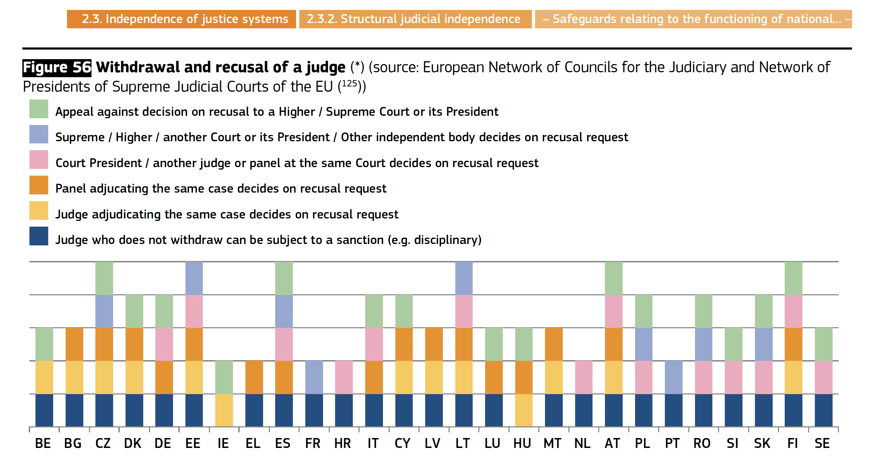
Eu justice scoreboard (2013)
Notes:
https://commission.europa.eu/strategy-and-policy/policies/justice-and-fundamental-rights/upholding-rule-law/eu-justice-scoreboard_en
https://ec.europa.eu/commission/presscorner/detail/en/ip_25_1693
https://ec.europa.eu/commission/presscorner/detail/en/qanda_25_1694
New in 2025: The Scoreboard contains, for the first time, data relevant for the Single Market in all Member States.
Also includes new or remodelled figures that enhance our understanding of inter alia
judicial mechanisms in place to ensure the implementation of administrative court judgments;
withdrawal and recusal of judges;
appointment and dismissal of heads of prosecution offices; public procurement review bodies; national competition authorities; and the supreme audit institutions;

Slide 46
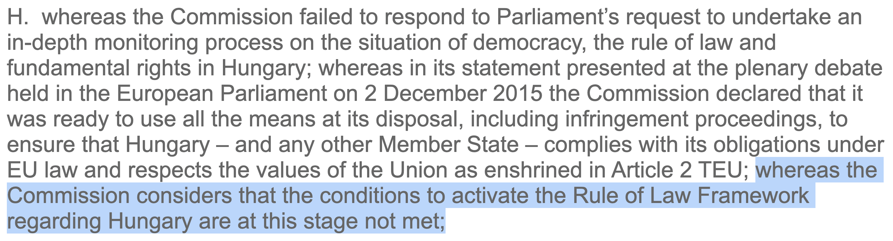
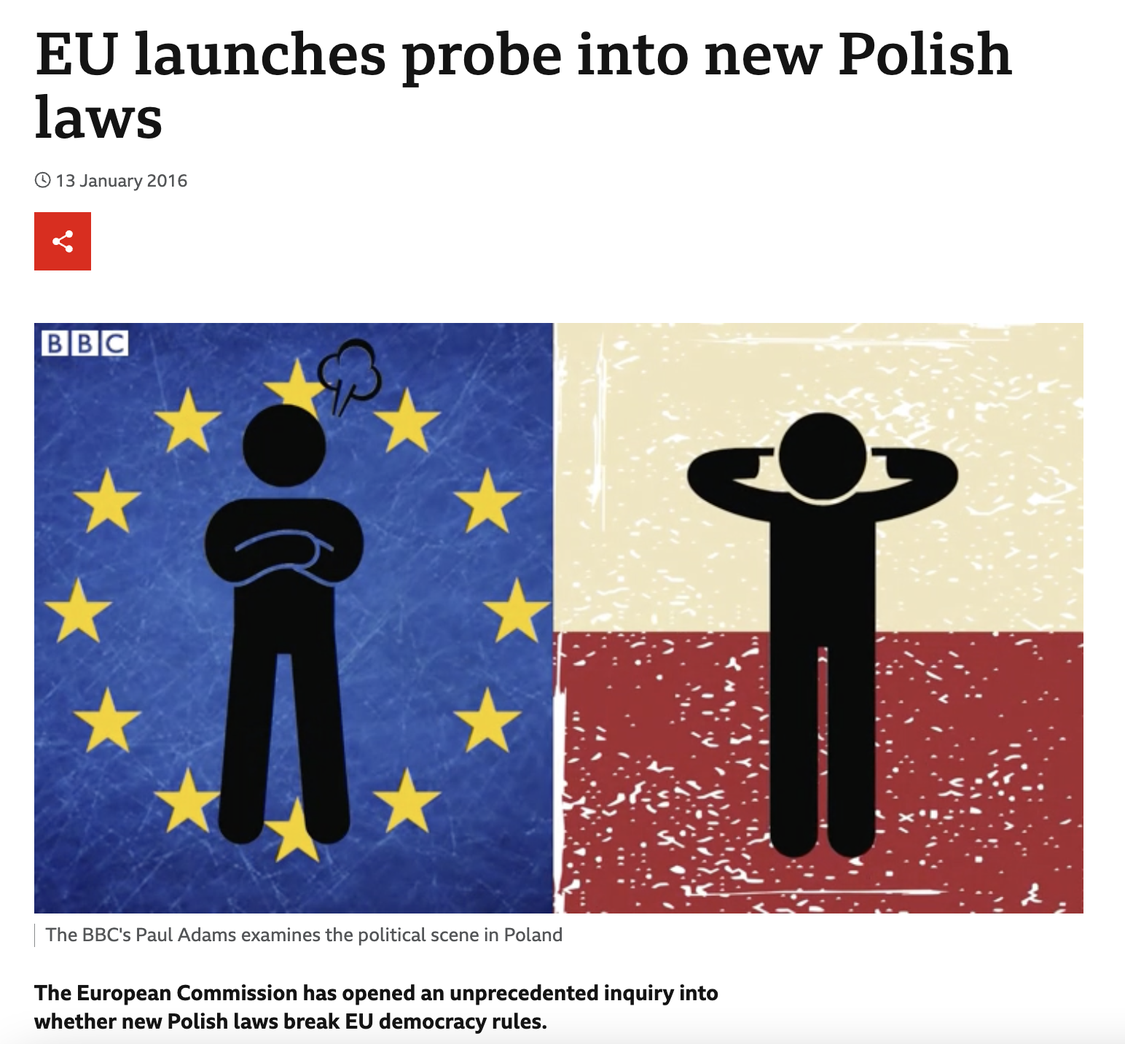
The commission’s rule of law framework aka pre-article 7 procedure (2014)
Notes:
Re Hungary: https://www.europarl.europa.eu/doceo/document/TA-8-2015-0461_EN.html?redirect

Slide 47
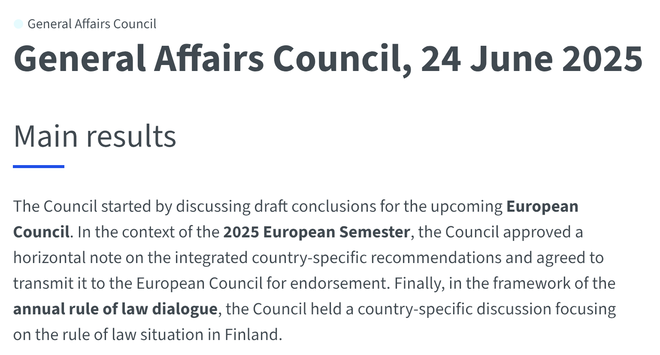
The Council’s rule of law dialogue (2014)
Notes:
https://www.consilium.europa.eu/en/meetings/gac/2025/06/24/

Slide 48
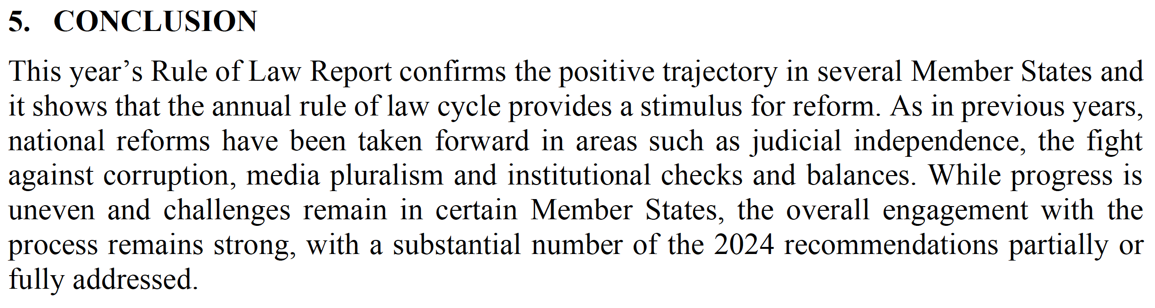
Annual rule of law report (2020)
Notes:
My 2020 assessment:
Failure to see the wood for the trees = reports don’t connect the dots and do not offer assessment of countries’ adherence to the rule of law over time = non-experts unlikely to be able to appreciate ongoing severe process of autocratisation in some countries
Denial of reality: Use of diplomatic diplomatic/euphemistic language (e.g. “reforms”) at times increases risks of normalising obvious crimes against the rule of law
Denial of autocratic reality = no clear emphasis that not all rule of law shortcomings are of the same nature and/or of same degree = some are deliberate/calculated and aim to create electoral autocracies
Category error = no explicit acknowledgement that e.g. Hungary is no longer a democracy = Commission ends up treat equally different situations in the name of treating EUMS equally = comparing oranges with mushrooms (no-comestible kind) which has already led to increased whataboutism
False expectation: annual reporting cycle will do nothing to prevent deliberate/systemic violations of the rule of law and deter legal hooligans as this is for now a mere ATE reporting mechanism with no recommendations, deadlines, follow up, etc.
Distracting effect: Production of this report appears to have cannibalised the focus, energy and limited resources of the Commission, with very little/painfully slow enforcement of rule of law requirements

Slide 49
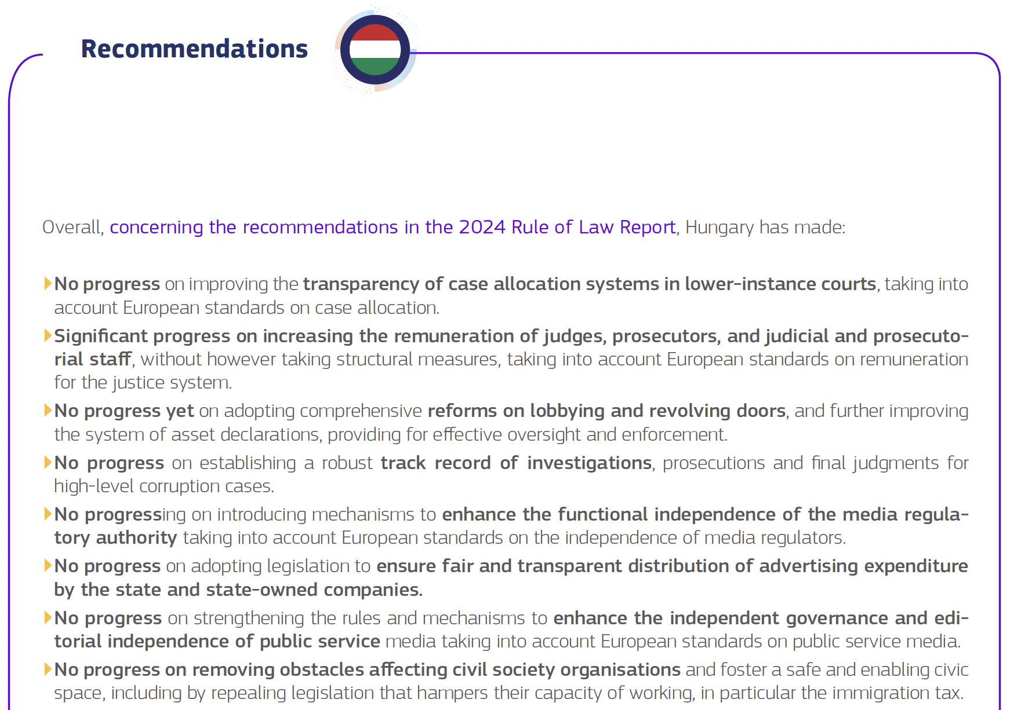

Slide 50
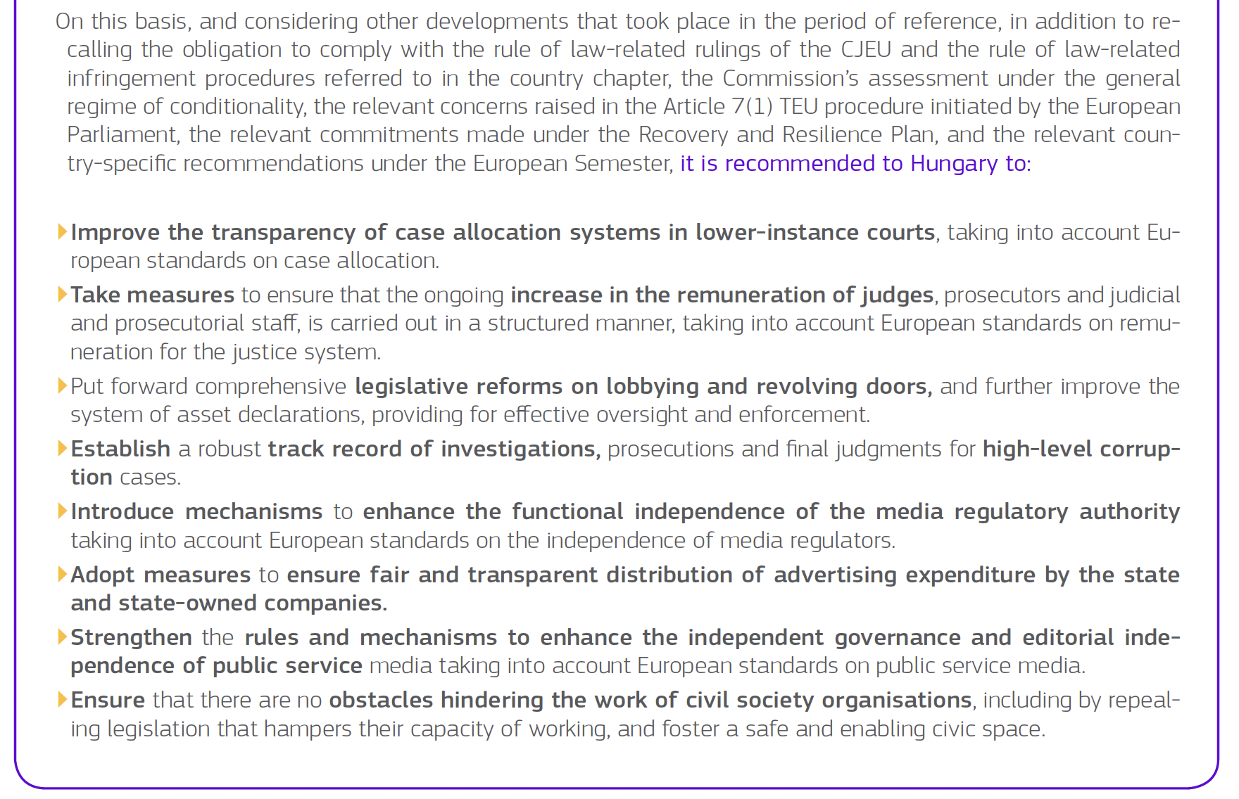

Slide 51
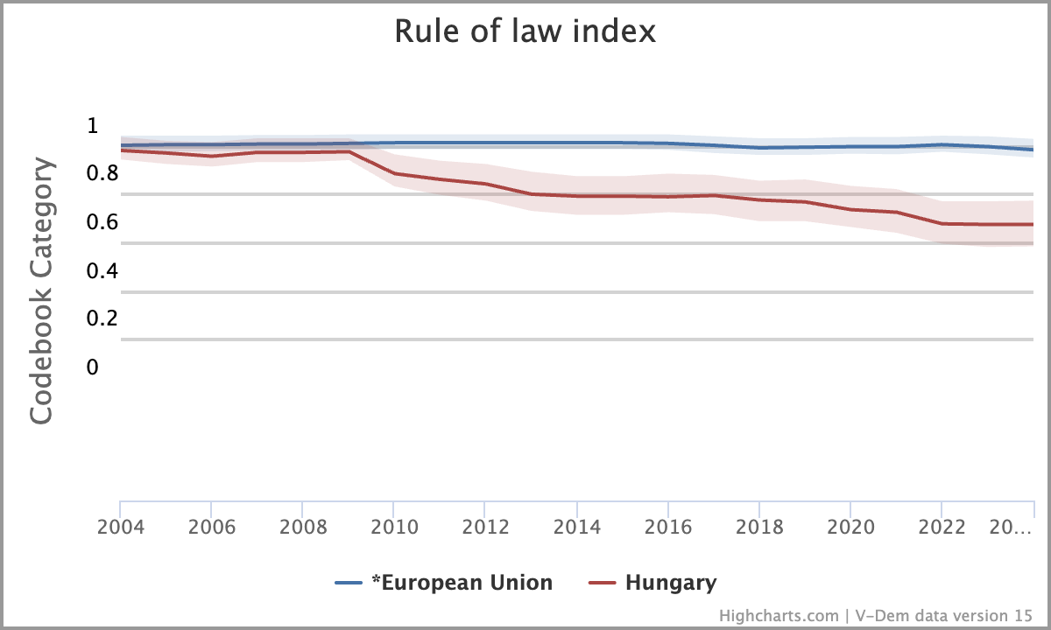
Meanwhile, in the real world…

Slide 52
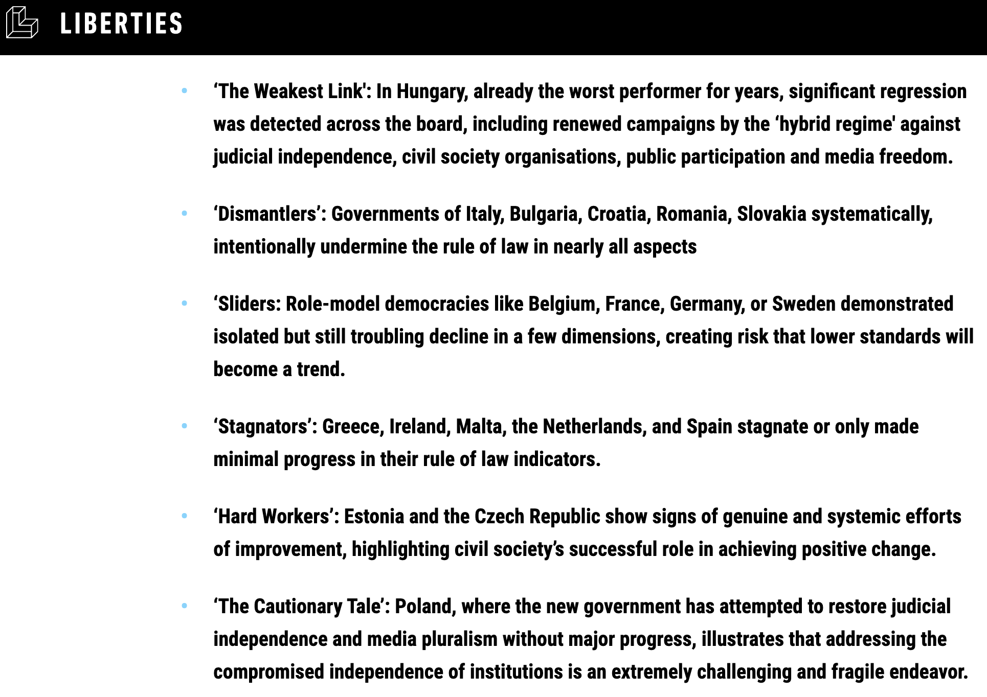
Compare to the Liberties Rule of Law Report 2025
Notes:
https://www.liberties.eu/en/stories/rolreport2025-pressrelease/45331
Explain why some EUMS not detected by previous RoL and/or Democracy measuring tools or assess differently (e.g. Greece not seen as backsliding but stagnating acc to Liberties)
Key explanations: focus on different factors + time lag (with WJP having a 12-month time lag compared to more reactive/qualitative assessments made by Liberties members which furthermore focus on 4 RoL aspects only as selected by EU Comm for its ARoLR)
Also: Sometimes difficult to measure dual state aspects

Slide 53
III.2 the EU’s rule of law response/enforcement tools in practice

Slide 54
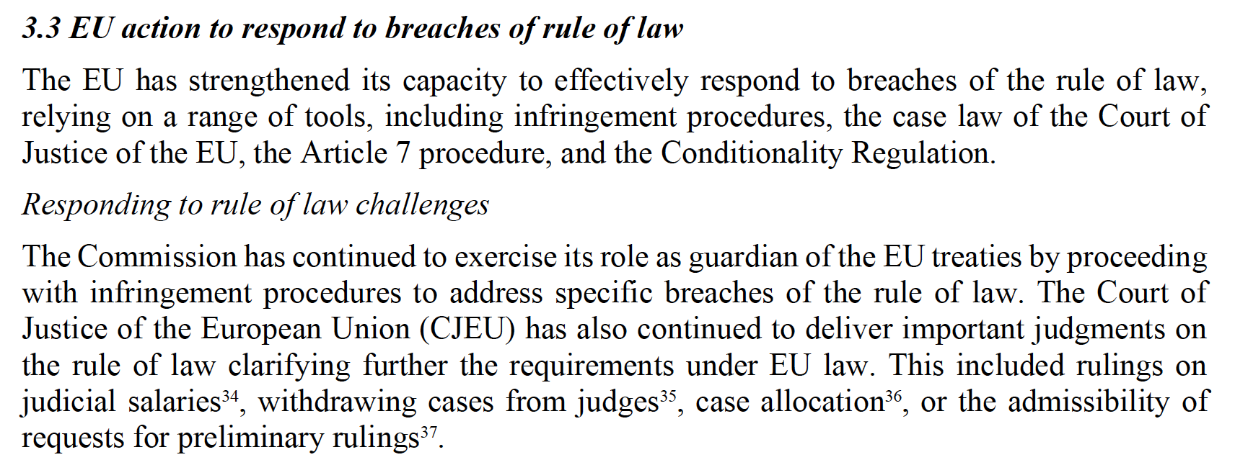
Infringement procedure:
Articles 258-260 and article 279 TFEU
(1958 but subsequently revised)
Notes:
Source: 2025 ARoLR transversal report, p. 9
NB: “Responding to rule of law challenges” to refer to VIOLATIONS of EU rule of law requirements
NB: 4 judgments mentioned are not infringement rulings.
Judgment of 25 February 2025, Joined Cases C‑146/23 and C‑374/23, clarifying that under Article 19(1) TEU, rules for determining the remuneration of judges must be objective, foreseeable, stable, transparent and enshrined in law.
Judgment of 6 March 2025, Joined Cases C-647/21 and C-648/21, held that legislation enabling decisions to withdraw cases from a judge is contrary to Article 19(1) TEU if they are not based on objective and precise criteria set out in law or with safeguards against arbitrary decisions.
Judgment of 14 November 2024, Case C-197/23, held that EU law precludes national legislation which prevents a court of appeal from reviewing the reassignment of a case to another judge at first instance.
Judgment of 7 November 2024, Case C-326/23.

Slide 55
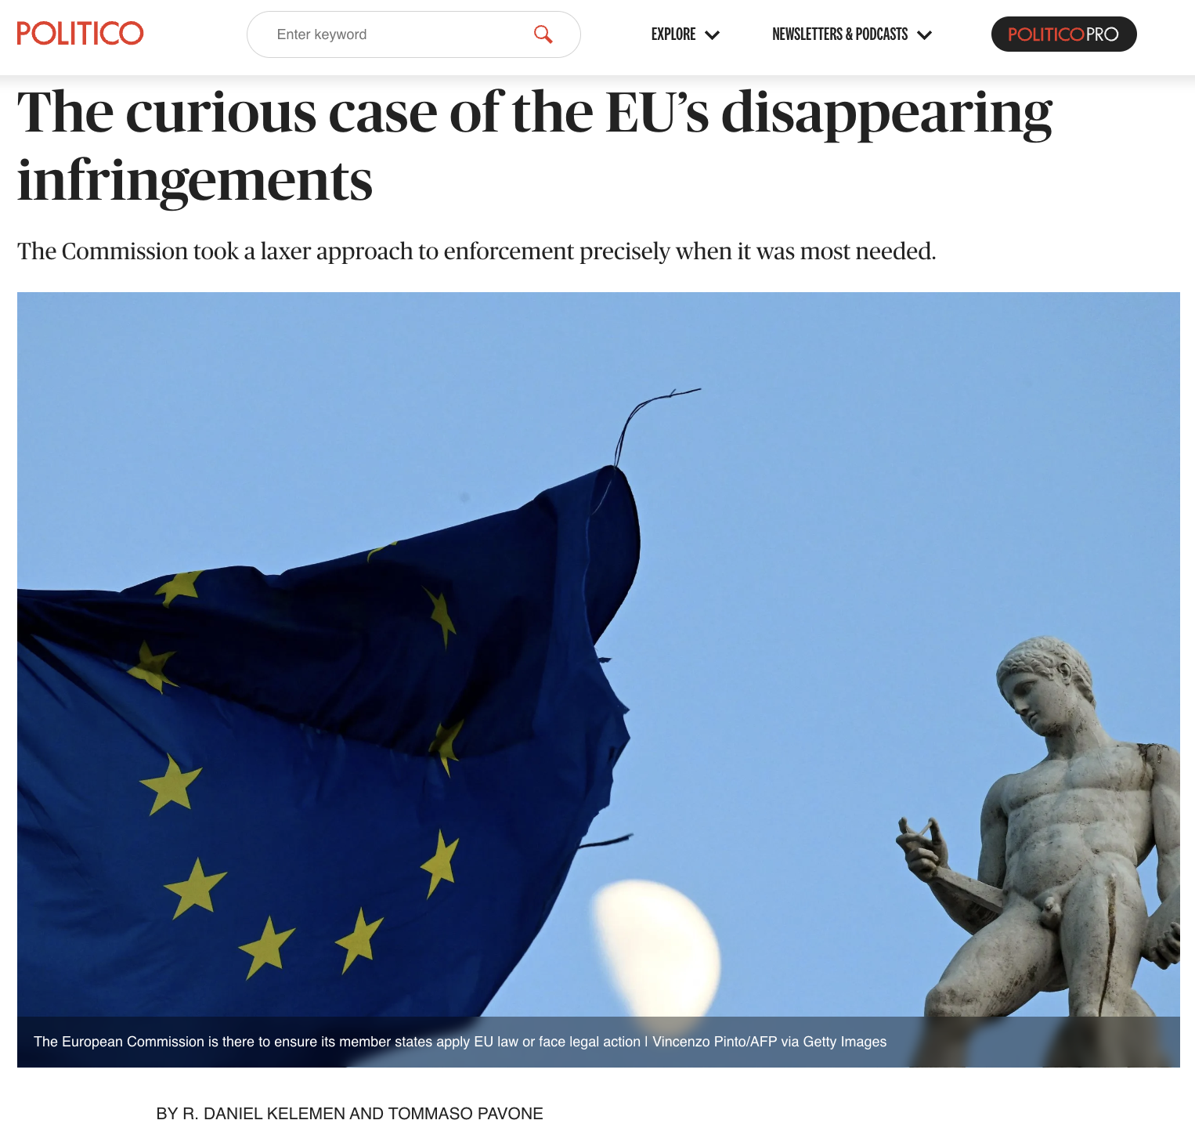
Reality check: Very few infringements v unprecedented increase in preliminary ruling requests
Rhetoric: “The European Union is a community of law, based on common values shared by Member States. Applying and enforcing EU law, and respect for the rule of law are at its very foundation” (EU Commission, Enforcing EU law for a Europe that delivers, 13 Oct 2022)
Reality check: “the Commission’s reluctance to bring enforcement actions took root at a particularly bad time: shortly before member governments like Hungary and Poland started to autocratize … precisely when muscular use of the EU’s legal tools was imperative” (Profs Kelemen and Pavone)
Notes:
https://www.politico.eu/article/curious-case-eu-disappearing-infringements/
See also: “full respect for the rule of law … is at the heart of Commission priorities” / “We have opened many infringement procedures”
In July 2021, President von der Leyen defended her Commission’s rule of law enforcement record as follows: “Since the beginning of my mandate, we have launched around 40 infringement cases linked to the protection of the rule of law and of other Union values laid down in Article 2 of the Treaty”

Slide 56
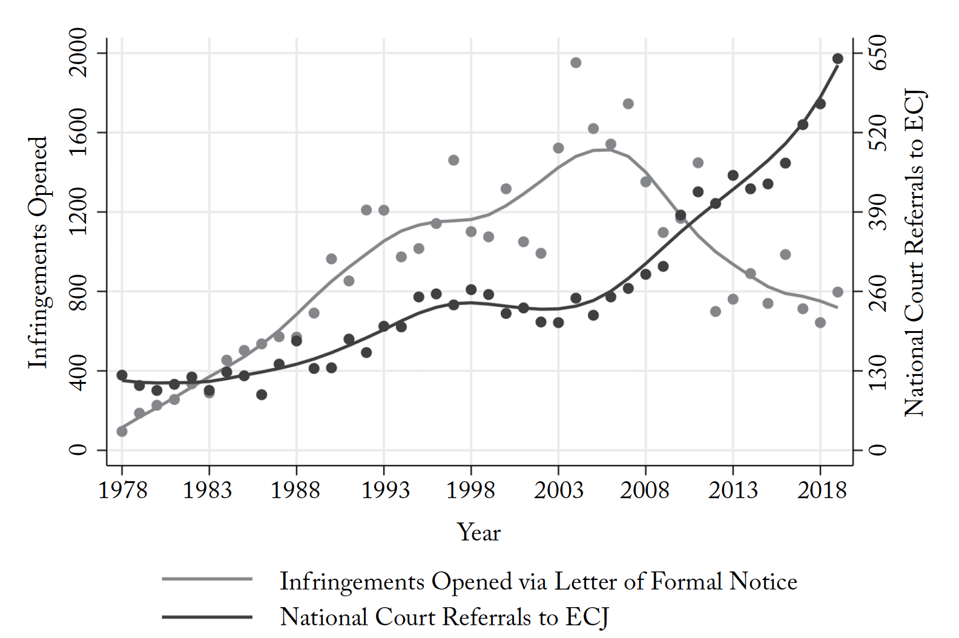
Notes:
Source: Kelemen, R. Daniel and Tommaso Pavone. "Where Have the Guardians Gone? Law Enforcement and the Politics of Supranational Forbearance in the European Union." World Politics, vol. 75 no. 4, 2023, p. 779-825
https://muse.jhu.edu/pub/1/article/908775/pdf

Slide 57
Impact of rule of law backsliding on CJEU case law impact
Notes:
Source: https://www.tandfonline.com/doi/full/10.1080/13501763.2024.2336125

Slide 58
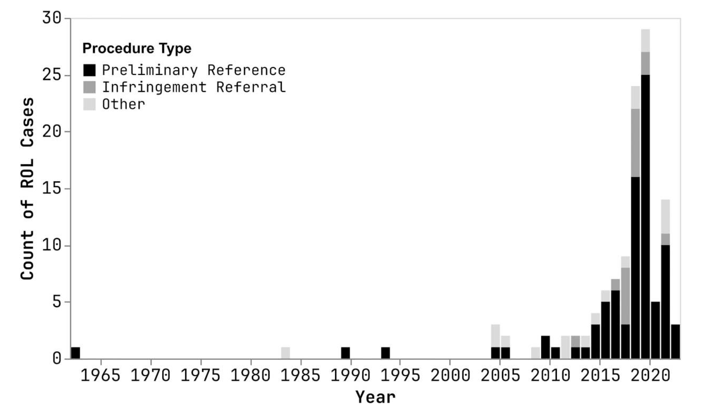

Slide 59
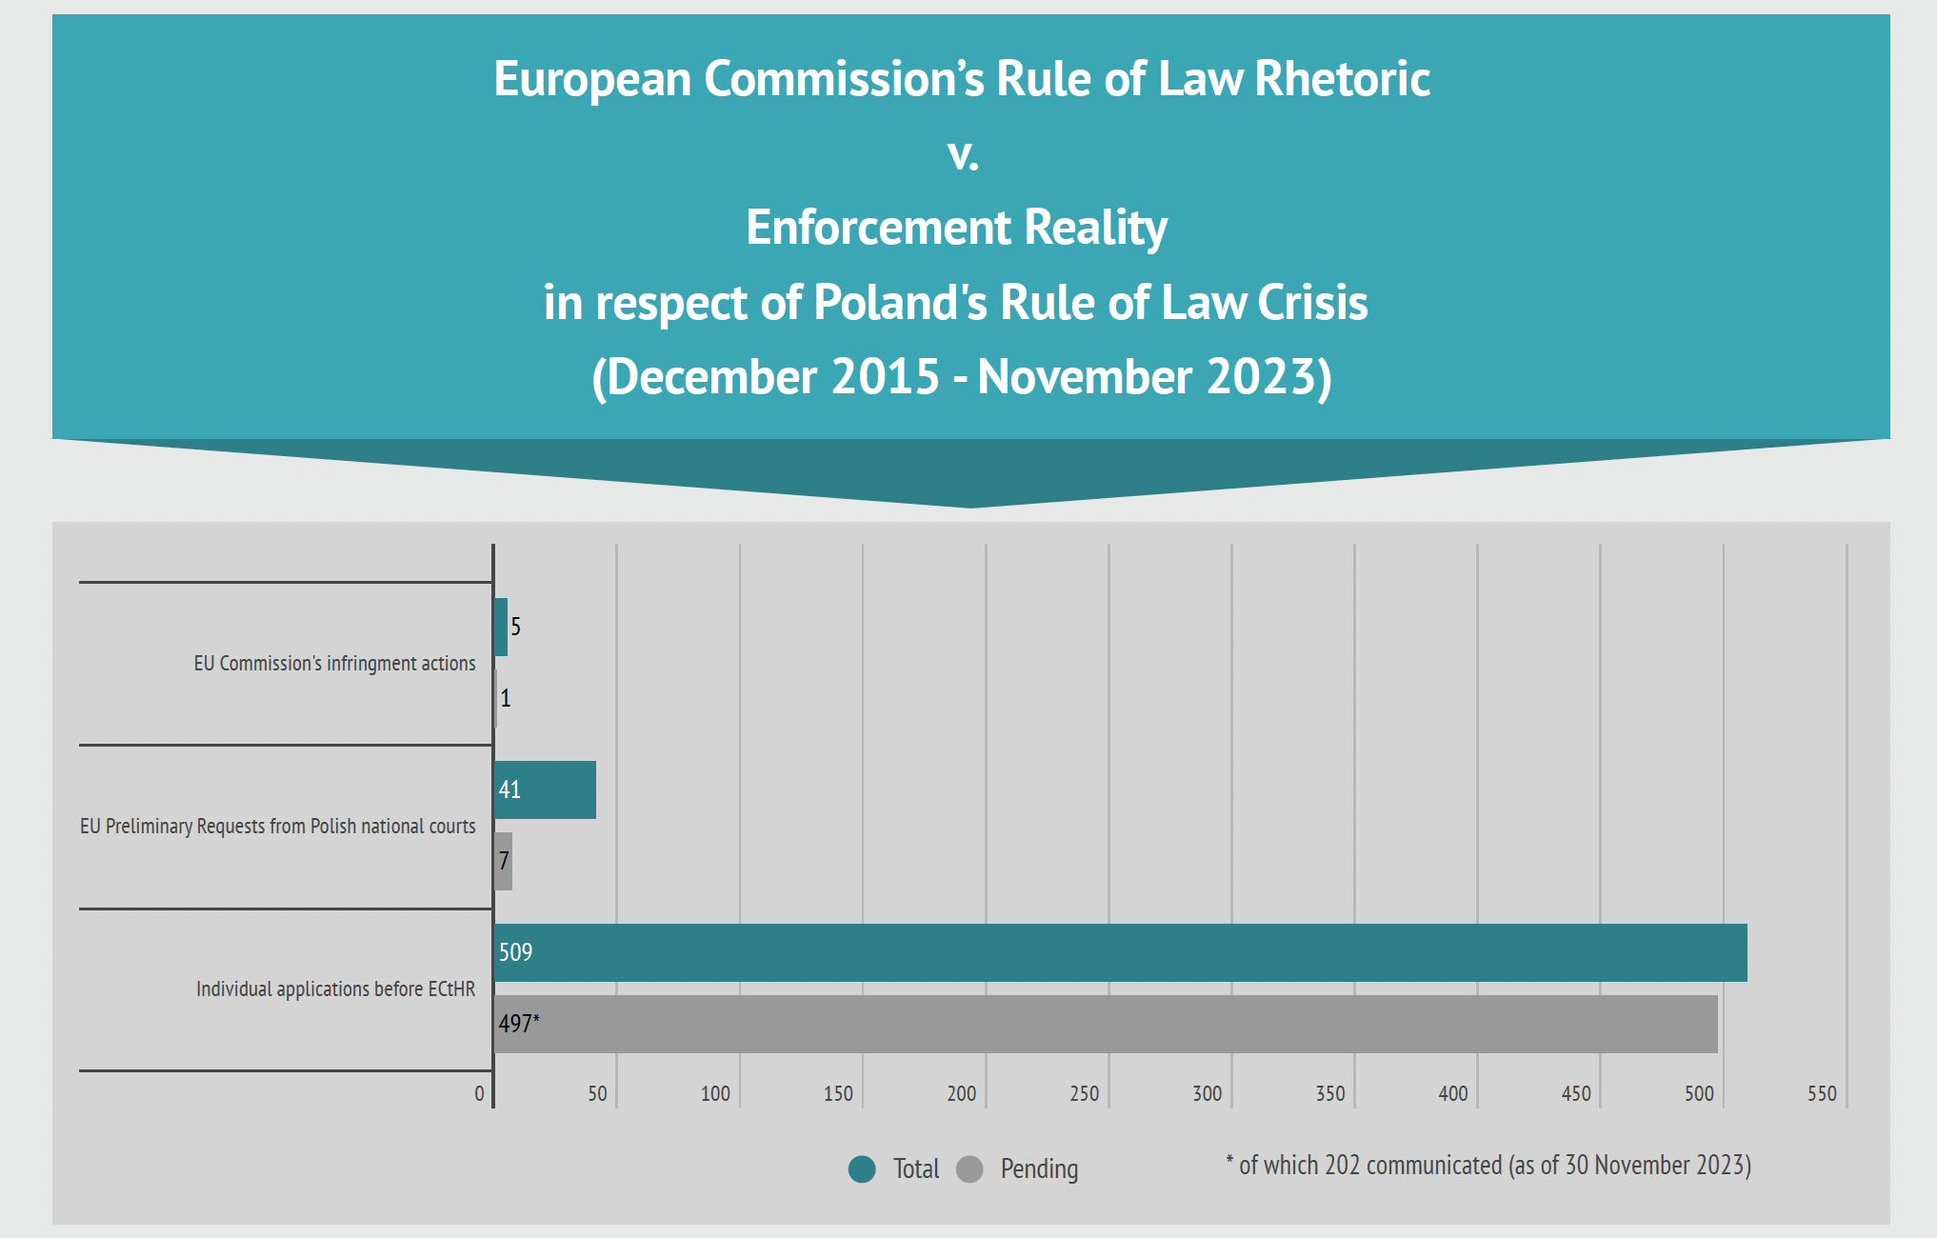

Slide 60
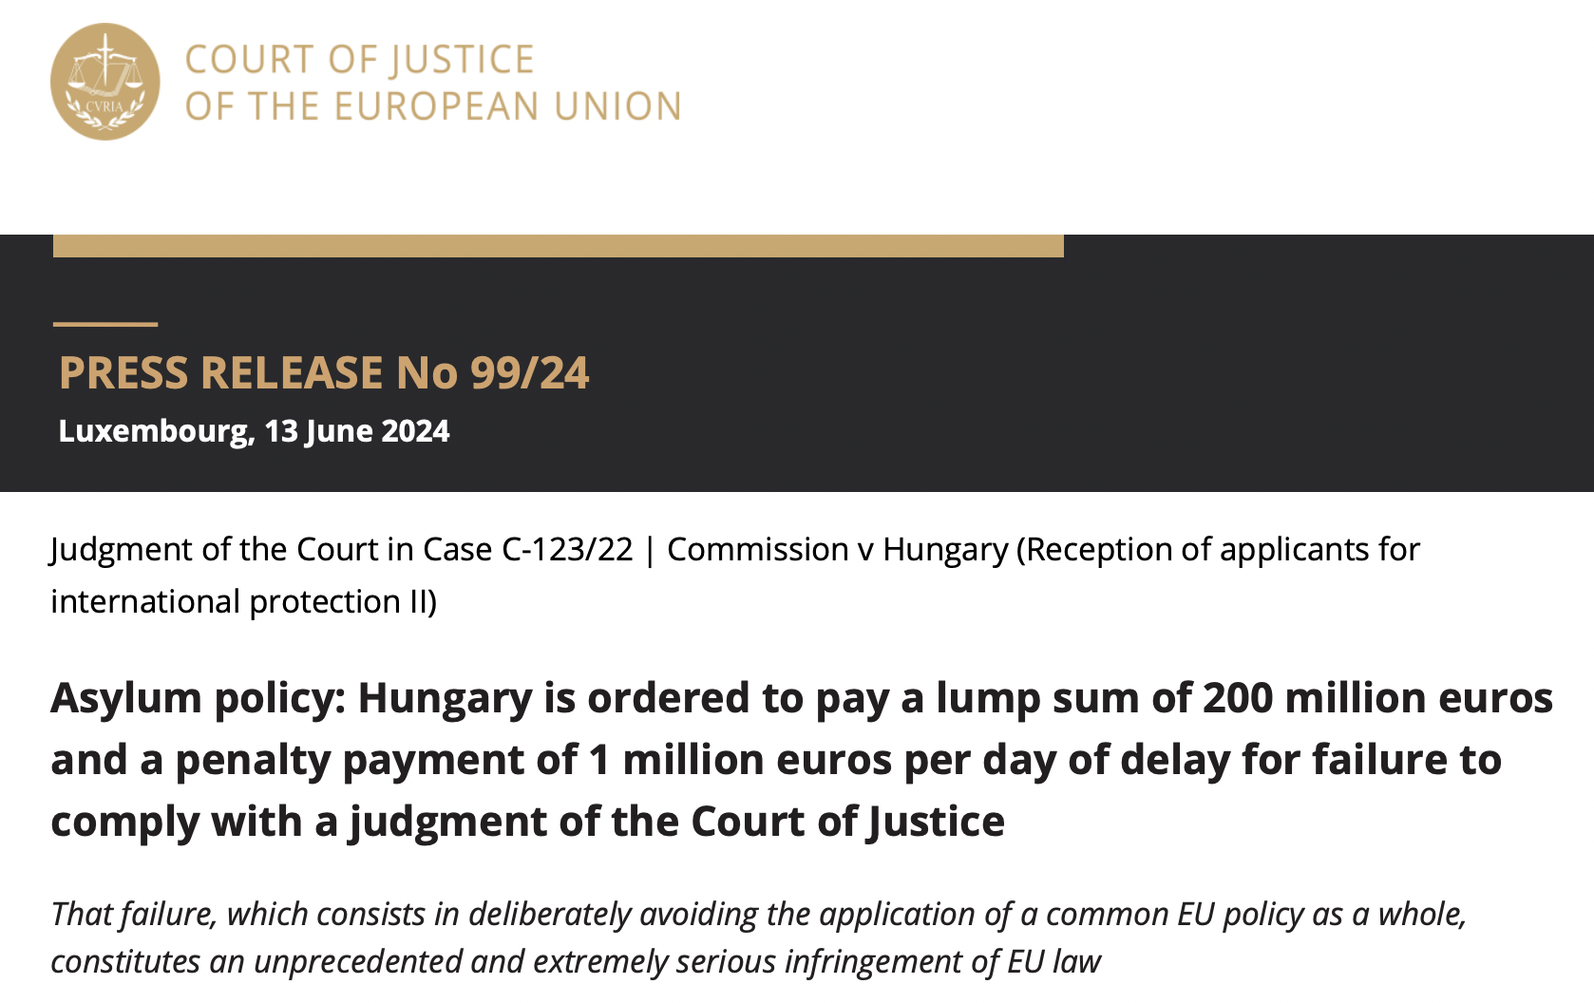

Slide 61

New/major development: financial penalties for non-compliance with ECJ interim measures under Art 279 TFEU

Slide 62

Sanctioning arm of Article 7 TEU
(1999)
Notes:
Reminder: Added by Treaty of Amsterdam
https://www.euronews.com/my-europe/2025/05/26/no-majority-among-eu-countries-to-sanction-hungary-over-rule-of-law

Slide 63

Conditionality tools since 2021
(some of them are wrongly presented as preventive tools)
Notes:
https://www.eca.europa.eu/en/news/NEWS-SR-2024-03

Slide 64

NB Reflects situation up to Dec 2023
Notes:
Source: 2024 CoA report

Slide 65

NB Reflects
situation
up to
Dec 2023
Notes:
Source: 2024 CoA report

Slide 66

Violating EU (rule of) Law for (geo)political reasons:
2022 example
Notes:
See also from April 2024: “The European Commission has today given a positive assessment of Poland’s recovery and resilience plan, an important step towards the EU disbursing €23.9 billion in grants and €11.5 billion in loans under the Recovery and Resilience Facility (RRF) […] Poland's plan contains several reforms to improve the investment climate in Poland. This includes a comprehensive reform of the disciplinary regime applicable to Polish judges”

Slide 67

Violating EU (rule of) Law for (geo)political reasons:
2023 example

Slide 68

Violating EU (rule of) Law for (geo)political reasons:
2024 example
(see also closure of art 7)

Slide 69
Court of auditors
For the single case in which measures were taken under the Conditionality Regulation (Hungary, 2022), the proposal to block money was duly justified. However, for countries other than Hungary, the auditors could not always verify the reasons for using one tool rather than another.
[A]lthough decisions not to block or to release EU funds should be based on technical and legal analysis, the EU auditors emphasise that political considerations may ultimately play a major role.”
Notes:
https://www.eca.europa.eu/en/news/NEWS-SR-2024-03

Slide 70


Further reading

