Slide 1
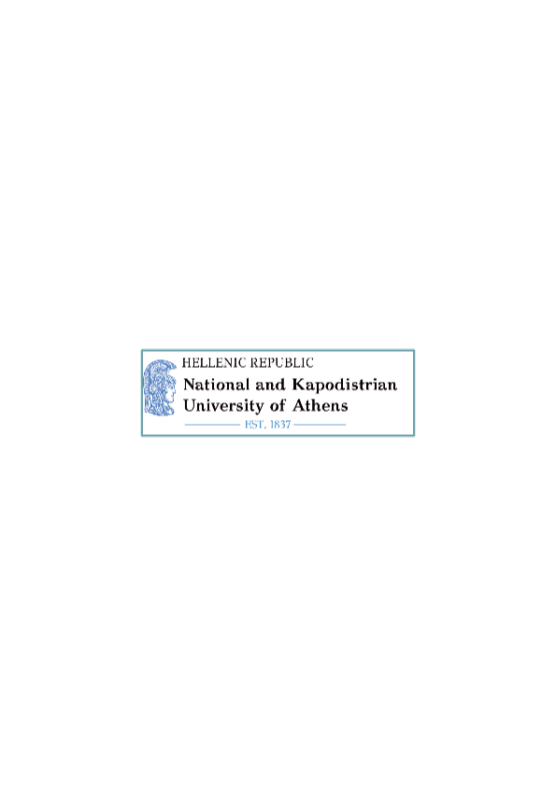

Conditionality as an Effective Instrument for Ensuring Respect for the Rule of Law in the EU?
Rule of Law and Fundamental Rights Protection in the EU
Jean Monnet Module Summer School
1.-6. September 2025

Slide 2

Content
The Concept of Conditionality
The Rule of Law Crisis in the EU
The Conditionality Regulation – New Mechanism to protect the Rule of Law?
The Conditionality Regulation: Procedures and Practical Application
Conditionality´s Effectivness for the Protection of the Rule of Law
Multiple Layers of Protection of the Rule of Law by Conditionality Instruments
Conclusion: The Rise of Conditionality within the EU

Slide 3
The Concept of Conditionality

Slide 4

General Definition of Conditionality
A procedure, in which the granting of certain benefits is linked to the implementation of specific political measures or the fulfilment of certain conditions or of a given behaviour.
The behaviour of the receiving party can be controlled by awarding of aid (positive Conditionality) or by restricting of aids (negative Conditionality).

Slide 5
General Definition of Conditionality
Ex-ante Conditionality: certain conditions have to be fulfilled before an aid or a sanction is issued.
Ex-post Conditionality: the mechanism of conditionality is issued after the receiving party starts to change or to adopt its politics.

Slide 6

The Concept of Conditionality within the EU
Originally, the concept of Conditionality in the EU was mainly used as an external relations tool.
Mechanisms of political conditionality have been deployed since the 1990s in trade agreements and development policies.

Slide 7
Conditionality within the Context of Accession to the European Union
Art. 49 TFEU: the acceding state must be a European state and must observe the EU´s fundamental values as provided by Art. 2 TEU.
Copenhagen Accession Criteria: accession candidates must develop into stable and mature democracies and constitutional states and into functioning market economies.
→ Ex-ante Conditionality

Slide 8
Conditionality within the Context of the Economic and Monetary Union
Art. 140 TFEU and Protocol on the Convergence Criteria: EU Member States must prove their economic convergence and demonstrate its sustainability in order to join the Eurozone.
Together with the Stability and Growth Pact and the obligation of the Member States in Art. 126 TFEU to avoid excessive deficits in their public budgets, these convergence criteria became permanent conditions for participation in the Economic and Monetary Union Protocol on the Convergence Criteria.
→ Ex-ante Conditionality

Slide 9
Conditionalities were combined with sanctions.
Art. 126 TFEU: Membership in the Eurozone requires acceptance of and compliance with fiscal policy requirements. Any non-compliance with those requirements is associated with sanctions.
Turns positive Ex-ante Conditionality after joining the Economic and Monetary Union into a permanent punitive conditionality.
Fundamental control instrument.

Slide 10
First formal recognition of Conditionality in the Treaties in Art. 136 para. 3 TFEU.
Art. 136 para. 3 TFEU: “The Member States whose currency is the euro may establish a stability mechanism to be activated if indispensable to safeguard the stability of the euro area as a whole. The granting of any required financial assistance under the mechanism will be made subject to strict conditionality.”

Slide 11
Expansion of Conditionality Mechanism during the Eurocrisis
  Establishment of new instruments: European Stability Mechanism (ESM).
  Introduction of additional monitoring and control mechanisms to ensure compliance with the original conditionality of the European treaties.

Slide 12

Conditionality within the Context of the European Spending Policy
Almost all EU funding programmes and funds are linked to the implementation of specific requirements.
European “Spending Conditionality”: ever since the Multiannual Financial Framework 2014-2020 under the Common Provisions Regulation (CPR).
CPR introduced several Ex-ante Conditions that Member States needed to fulfil in order to get access to EU funding.
→ ”Power of Purse”.

Slide 13

The Rule of Law Crisis in the EU

Slide 14
The Rule of Law Crisis in the EU
Hungary
Spring 2011: start of enacting various amendments to its Fundamental Law.
Changes of the Hungarian constitutional system to dismantle the Constitutional Court → attacking independence of judiciary.
EU Parliament: the breakdown of democracy, the Rule of Law and Fundamental Rights in Hungary turn the country into a regime of electoral autocracy.
Poland
Start of judicial reforms in 2015: changes to the Constitutional Tribunal, the National Council of the Judiciary, and the Supreme Court in order to bring these bodies under political control.
Most contentious issue: establishment of the Disciplinary Chamber of the Supreme Court, which has the power to discipline judges → undermines judicial independence by allowing political influence over the judiciary.

Slide 15
European Rule of Law Toolbox and their Deficits
Not a product of strategic engineering
Target only specific violations of EU law
Formal dialogues instead of credible and effective incentives for compliance
High decision-hurdles (Art. 7 TEU)
“Veto Play” between Member States
→ Need for a new mechanism/ more effective tool.

Slide 16
The Conditionality Regulation – New Mechanism to Protect the Rule of Law?

Slide 17
Legislative Procedure and Implementation of the Regulation
The Commissions First Proposal of the New Mechanism
Protection of the Union´s budget in case of “generalised deficiencies” regarding the Rule of Law in the Member States.
The Council
Aim of the Regulation shall be the proper use of EU funds at national level and thus, the protection of the EU Budget.

Slide 18
Due to the limited competences of the EU, the Commission used a technical legal basis: Art. 322 para. 1 lit. a TFEU.
The Council questioned the compatibility of the Commission´s proposal with EU law, in particular with Art. 7 TEU:
  Secondary legislation cannot amend, supplement or circumvent Art. 7 procedure.
→ Disagreement between Council and Commission.

Slide 19
Ambiguity of the real goal of the proposed new Regulation
VS
Protecting the EU Budget and the sound financial management of EU resources
Ensuring respect for the Rule of Law

Slide 20
Despite the disagreement, there was the need to finalize the MFF before the end of 2020.
Agreement could finally be reached under the conditions agreed in the Conclusions of the European Council in December 2020: development and finalizing of guidelines after CJEU judgment.
Regulation entered into force in January 2021.
Hungary and Poland contested Regulation in front of the CJEU.

Slide 21
CJEU´s Findings
Art. 322 (1) (a) TFEU is a proper legal basis
No circumvention of Art. 7 TEU
Respecting Art. 2 TEU values is prerequiste of the excercise of all rights stemming from the Treaties – permanent binding obligation → „they define the identity of the EU“
EU must be able to defend these values, within the limits of it´s powers as laid down by the Treaties
→ Conditionality Regulation is not a general sanctioning mechanism, but a targeted budgetary tool to safeguard EU funds.

Slide 22
The Conditionality Regulation: Procedures and Practical Application

Slide 23
Art. 1 of the Conditionality Regulation – The Scope of the Regulation
“This Regulation establishes the rules necessary for the protection of the Union budget in the case of breaches of the principles of the rule of law in the Member States.”

Slide 24
Art. 4 of the Conditionality Regulation
“Appropriate measures shall be taken where it is established in accordance with Art. 6 that breaches of the principles of the rule of law in a Member State affect or seriously risk affecting the sound financial management of the Union budget or the protection of the financial interests of the Union in a sufficient direct way. “

Slide 25
Conditions for the adoption of measures
breaches of the principles of the rule of law
that affect or seriously risk affecting the sound financial management of the Union budget or the protection of the financial interests of the Union
in a sufficient direct way
no other procedures set out in Union legislation would allow it to protect the Union budget more effectively (subsidiarity)

Slide 26
Art. 2 (a) of the Conditionality Regulation
“(a) the ”rule of law” refers to the Union values enshrined in Art. 2 TEU. It includes the principles of legality implying a transparent, accountable, democratic and pluralistic law-making process; legal certainty; prohibition of arbitrariness of the executive powers; effective judicial protection, including access to justice by independent and impartial courts, also as regards fundamental rights; separation of powers; and non-discrimination and equality before the law. The rule of law shall be understood having regard to the other Union values and principles enshrined in Article 2 TEU. (…)”

Slide 27
Art. 3 of the Conditionality Regulation
“(…) the following may be indicative of breaches of the principle of the rule of law:
Endangering the independence of judiciary;
Failing to prevent, correct or sanction arbitrary or unlawful decisions by public authorities, including by law-enforcement authorities, withholding financial and human resources affecting their proper functioning or failing to ensure the absence of conflicts of interest;
Limiting the availability and effectiveness of legal remedies, including through restrictive procedural rules and lack of implementation of judgments, or limiting the effective investigation, prosecution or sanctioning of breaches of law.”

Slide 28
Art. 4 (2) of the Conditionality Regulation
“(…) breaches of the principles of the rule of law shall concern one or more of the following:
The proper functioning of the authorities implementing the Union budget, including loans and other instruments guaranteed by the Union budget, in particular in the context of public procurement or grant procedures;
The proper functioning of the authorities carrying out financial control, monitoring and audit, and the proper functioning of effective and transparent financial management and accountability systems;
The proper functioning of investigation and public prosecution services in relation to the investigation and prosecution of fraud, including tax fraud, corruption or other breaches of Union law relating to the implementation of the Union budget or the protection of the financial interests of the Union;
The effective judicial review by independent courts of actions or omissions by the authorities referred to in points (a), (b) and (c);
The prevention and sanctioning of fraud, including tax fraud, corruption or other breaches of Union law relating to the implementation of the Union budget or to the protection of the financial interests of the Union, and the imposition of effective and dissuasive penalties on recipients by national courts or by administrative authorities;
The recovery of funds unduly paid;
Effective and timely cooperation with OLAF and, subject to the participation of the Member State concerned, with EPPO in their investigations or prosecutions pursuant to the applicable Union acts in accordance with the principles of sincere cooperation;
other situations or conduct of authorities that are relevant to the sound financial management of the Union budget or the protection of the financial interests of the Union.”

Slide 29
Sufficient Direct Link
CJEU: requires a “genuine” link between the breach of the rule of law and the EU budget.
However, the Court does not go into further detail when such genuine link is established.
The Commission´s Guidelines: notion of “genuine” link refers to the fact that the Regulation “should not be triggered with regard to situations in which the connection is merely hypothetical, too uncertain or too vague.”

Slide 30
Sufficient Direct Link
Clear direct link: If breach of rule of law results from actions or omissions by public authorities in charge of managing and controlling the use of EU funds.
Scenario 1: In the case of adoption of national law or a nationwide administrative decision → “sufficient direct link” (+) if national law infringes rule of law principles and has concrete and direct implications for measures eligible under EU spending programmes implemented by national public authorities.

Slide 31
Sufficient Direct Link
Scenario 2: rule of law breach stems from actions or omissions of public authorities not directly involved in the use of EU funds but playing a role in the protection of the EU´s financial interests (for example national public prosecution services, judicial authorities or administrative authorities).
  Under a strict interpretation: the mere lack of independent judiciary would not suffice to establish a sufficient direct link. Evidence would be needed.
  Under a broader interpretation: if there is strong evidence of total absence of independence of judiciary, there is a clear and serious risk of lack of effective judicial review over the actions of public authorities in charge of managing and controlling of EU funds.
→ CJEU jurisprudence on the notion of “sufficient direct link” is still needed.

Slide 32
Procedure and Measures of the Regulation
Art. 6 CR: the procedure shall be triggered by the Commission under two conditions:
  if it considers that there are reasonable grounds to find that the situation in a Member State meets the criteria established in Art. 4 CR and
  if the Commission considers that no other procedure set out in EU law would allow to protect the EU budget more effectively (→ Subsidiarity of the Regulation).
→ ex-post Conditionality

Slide 33
Procedure and Measures of the Regulation
Art. 5 CR: the Commission may adopt one or more measures.
Art. 5 (3) CR: measures shall be proportionate.
Art. 8 CR: European Parliament does not participate in the application of the Regulation, but Commission is obliged to inform it accordingly.

Slide 34
Lifting of Measures of the Regulation
Art. 7 CR: Member State concerned may adopt remedial measures and submit written observations with evidence to the Commission anytime.
Art. 7 CR: at least within a year, the Commission reassesses the situation and examines the remedial measures → either lifting the adopted measures or altering the measures accordingly.
→ The existence of Art. 7 CR of the Regulation and the possibility to lift measures underlines that the Regulation is a budgetary conditionality instrument.

Slide 35
Procedure and Measures of the Regulation
Initiating the procedure by Commission: written notification of Member State.
Member State makes its comments on the notification and may propose remedial measures to address the indicated shortcomings.
Evaluation by the Commission.
Commission observes proportionality of the measures.
If Commission is not satisfied, it submits its proposal to the Council for an implementing decision.
The Council adopts the implementing decision or amend the proposal of the Commission.
Reassessment by the Commission.

Slide 36
Practical Application and Challenges
Commission triggered the first procedure against Hungary only in April 2022 → 1 1/2 years after it entered into force.
Commission raised concerns a number of issues related to the public procurement → Hungarian authorities were systematically unable, unwilling or failing to handle these issues and tackle corruption
These violated the rule of law principles, namely
  legal certainty and
  the prohibition of arbitrariness of the executive power
  the separation of powers and effective judicial protection.

Slide 37
Practical Application on Hungary
Commission´s Conclusion:
The legal and practical deficiencies were structural, widespread and present for more than 10 years and, as such, seriously risked to affect the EU´s financial interests.
no other mechanims under EU law could protect the EU´s budget (= subsidiarity).

Slide 38
Practical Application on Poland?
No application of the Conditionality Regulation in the case of Poland.
Why? No “sufficient direct link” between breach of rule of law and EU budget.
Rule of Law infringement only concerned laws that enabled the executive or legislative powers systematically → the independence of judiciary and the separation of powers has been affected seriously, but no sufficient direct link to the EU budget.
2024: New polish government introduced Rule of Law Action Plan.

Slide 39
Conditionality´s Effectiveness for the Protection of the Rule of Law

Slide 40
Benefits of the Conditionality Regulation
More promptly actions by the EU
Prevention of veto plays
Significant and specific sanctions
More effective than other infringement procedures due to its
  procedural efficiency,
  its time limits,
  specific measures.

Slide 41
Constitutional Deficits of Conditionality
No consideration of the possible effects on the EU´s vertical (between the EU and the Member States) and horizontal (between the EU institutions) balance of powers
Rise of Conditionality has an immense impact on EU key principles:
  Potential Negative Effects on the Principle of Equality
  Potential Negative Effect on the Principle of Mutual Trust
  Potential Risk of “Competence Creep”

Slide 42
Potential Negative Effects on the Principle of Equality
Formal equality: (+) as the Conditionality Regulation, as any other Regulation, applies to all Member States.
Substantive equality: questionable as the mechanism has a disproportionate impact on the Member States.
  → harsher impact on those Member States that receive larger amounts of EU funds.

Slide 43
Potential Negative Effects on the Principle of Mutual Trust
Art. 49 TEU: the European Union is composed of States which have freely and voluntarily committed themselves to the common values referred to in Art. 2 TEU → key principles of loyalty, solidarity and mutual trust
The widespread use of Conditionality, however, introduces a “donor-recipient” logic in the EU legal order.
→ Risk of shift from mutual trust to mutual distrust between Member States.

Slide 44
Potential Negative Effect on the Principle of Mutual Trust
Participation in Union policies and EU funding are key membership rights.
EU funding has never been seen as a reward for good compliance and good behaviour.
→ Scholars argue that the Union´s legal basis might shift towards a new “Conditionality Culture”.

Slide 45
Potential Risk of “Competence Creep”
Indirect “Europeanisation” of policy areas in which the EU has only limited options for action under primary law.
By linking the EU economic field and EU fundamental values an institutional shift in the EU might be established.
Expansion of its discretionary scope where it only shares competences with the Member States → this narrows the scope for national special paths.
→ Expansion without formal transfer of competences and amendment of the European Treaties.

Slide 46
Potential Risk of “Competence Creep”
In the EU, a centripetal effect may be problematic given the embedded tension between EU centralization and national powers in key policy fields that may be attracted via Conditionality.
→ Effect of “competence creep”: expansion concerns national Rule of Law Systems, where the EU has only limited competences.

Slide 47
Multiple Layers of Protection of the Rule of Law by Conditionality?

Slide 48
Multiple Layers of Protection of the Rule of Law by Conditionality?
RRF Conditionality
CPR Conditionality
Conditionality Regulation

Slide 49
The Recovery and Resilience Facility Regulation (RRF)
Main instrument of the NextGenerationEU Plan: direct financial support to the Member States in order to boost reforms and investments.
Rule of Law: fulfilment of agreed objectives defined through milestones and targets under the RRF; tailored to the concerned Member States as issues under the European Semster are adressed.
ex-ante Conditioning: providing access to the common treasury once the indicated obligations are met.

Slide 50
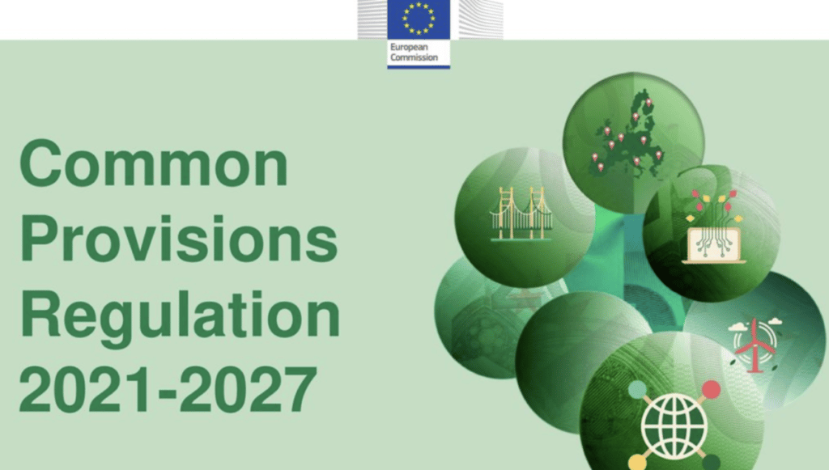
The Common Provisions Regulation (CPR)
Regulatory instrument concerning the use of EU cohesion policy funds: payment requests are connected to the specific objectives; compliance with several horizontal enabling conditions is required.
Rule of Law: Enabling Condition → „Effective application and implementation of the Charter“.
→ ex-ante Conditioning: providing access to the common treasury once the indicated obligations are met.

Slide 51
Synergy and Subsidiarity: the Relationship between the three Conditionality Regimes
Conditionality Regulation
Only applicable for cases of “sufficiently direct link”; other two Regulations do not contain such strict substantive criteria.
Primarily anti-corruption measure (as applied so far).
Ex-Post Conditionality.
RRF
One-off financial nudging system in order to promote certain policy goals, which opens up additional funding for the Member States, conditioned on certain requirements (“milestones”).
Ex-Ante Conditionality.
CPR
Permanent tool and has similar logic to the RRF.
Conditioning criteria more universal.
Ex-Ante Conditionality.
Focuses mainly on the protection of fundamental rights as enshrined in the Charter by the compliance of the programmes with it (“horizontal enabling condition”).
Optional.
No opt-out.
No opt-out.

Slide 52
Synergy and Subsidiarity: the Relationship between the three Conditionality Regimes
All three tools are only indirectly connected to the protection of Art. 2 TEU values!
The tools mutually support each other with complementary or even synergetic effect.
RRF and CPR usually do not overlap with each other (due to their respective specific funds).
In the case of freezing under the Conditionality Regulation, “double freezing” is possible if money is already non-accessible under CPR or RRF.
The subsidarity of the Conditionality Regulation does not exclude its overlapping application → rather, it enhances their overall synergetic effectivity.

Slide 53
(When) Is the Conditionality Regulation more effective?
Only tool that covers risks affecting all EU revenues and expenditure → widest range of possibilities to actually freeze funds.
The tool has widest financial scope.
High flexibility regarding measures → not only the Commission has a wide range of possible measures to propose, but the Member State concerned can propose and adopt remedial measures.

Slide 54
(When) Is the Conditionality Regulation more effective?
Fast procedure for solving problems: the mere thread of activating the Regulation may be sufficient to convince the Member State to adopt remedial measures.
Proving of fulfilment of the substantive criteria for triggering the tool are more cumbersome.
However, once the measures are in place, they are procedurally more difficult to lift: Commission proposes lifting and the Council will decide.
Notes:
than the measures under the two other Regulations (where the Commission alone decides).

Slide 55
Multiple Layers of Protection of the Rule of Law by Conditionality?
None of the Regulations aim directly and mainly the protection of Art. 2 TEU values.
Either they aim the protection of EU budgetary interest (Conditionality Regulation) or they protect Art. 2 TEU values just as a side-effect and/or partial aim (RRF and CPR).
Art. 2 TEU values are filtered through the prism of the respective financial tools.
Why? Art. 2 TEU itself may not serve as the legal basis for the adoption of secondary EU legislation (Art. 2 para. 6 TFEU).
Notes:
This is a consequence of the fact that the EU has only conferred competences, as enshrined in the Treaties.
In order to be able to serve as a legal basis for secondary legislation, a provision in the Treaties needs to identify the institutions that are empowered to adopt such acts, the type of acts, as well as the procedure for the adoption of the act. Art. 2 (6) TFEU: The scope and arrangements for exercising the Union´s competences shall be determined by the provisions of the Treaties relating to each area.

Slide 56
Multiple Layers of Protection of the Rule of Law by Conditionality?
Indirect approach on protection of Art. 2 TEU values could possibly alter the very notion of the rule of law with economic or financial implications
by resorting to sectoral policies, other dimensions of the rule of law are left behind → they continue to be adressed by non-binding / ineffective tools.

Slide 57
Multiple Layers of Protection of the Rule of Law by Conditionality?
All three Regulations give wide rooms for political considerations of the Commission.
The role of the European Parliament is legally marginal (only information obligations).
However, the European Parliament has indirect influence through its role in the formulation of policy choice, and naturally, in the legislation → as European Parliament exercises “political control” over the Commission.

Slide 58
Multiple Layers of Protection of the Rule of Law by Conditionality?
In the end: all decisions under all three Regulations can be challenged at the CJEU (e.g. by the European Parliament or by the concerned Member State).
→ It will therefore remain the task of the CJEU to ensure that Art. 2 TEU values are not fragmanted within the EU along geopolitical considerations and according to individual Member States.

Slide 59
Conclusion

Slide 60
The Rise of Conditionality within the EU
→ EU increasingly relies on Conditionality tools also internal in relation to its own Member States.
→ EU extended the concept over time to the area of its internal governance and in fields in which EU reaches the limits of its authority.
→ Permanent Conditionality Culture established?

Slide 61
Conclusion
The Conditionality Regulation only tackles infringements of the Rule of Law with a sufficient direct link to the EU budget.
The interpretation of a “sufficient direct link” between the breach of the Rule of Law and the EU budget still needs some guidance by CJEU jurisprudence in the future.
Conditionality remains the most effective instrument in order to prevent further democratic backsliding in the EU, in particular combined with other layers of budget control mechanisms.
Remaining question: other dimensions of Art. 2 TEU (with no EU budget relation) continue to be adressed by non-binding / ineffective rule of law tools?

Slide 62
Thank you for your attention! ☺
Renée Resch, LL.M. (Athens)
reschrenee@gmail.com

