Slide 1





The Romanian Constitutional Court facing the 2024 illiberal crisis - militant democracy?
Raluca Bercea, Professor, West University of Timisoara
Summer school, Athens, 2025

Slide 2
Militant democracy?
Timeline
06.12.2024 RCC annuls the entire electoral process
24.11.2024 First round of the presidential elections, unexpectedly won by an ultranationalist
05.10.2024 RCC annuls the candidacy of the head of the “SOS” far-right party
06.12.2024 The second round of the presidential elections starts in the diaspora.
02.12.2024 RCC confirms the general validity of the first round of presidential elections
01.12.2024 The parliamentary elections are won with difficulty by the Pro-European parties
28.11.2024 RCC decides the recount of all ballots cast and postpones the validation of PE
27.11.2024 RCC is requested to annul the first round for illegal financing of the campaign

Slide 3
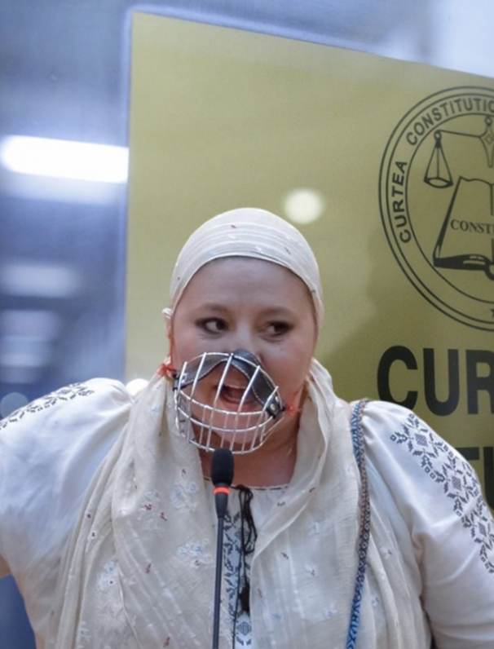
Militant democracy Act 1
RCC Decision no. 2 of 5 October 2024 - annuls the candidacy of the head of the “SOS” far-right party
The controversial legal point: the competence - in the framework of an objective electoral dispute [Art. 146 let. f) of the Constitution], RCC applies instruments designed to assess the constitutionality of a political party [Art. 146 let. k) of the Constitution], without the due procedural guarantees that only cover, according to the national law, the second hypothesis
The constituent legislator expressly regulated its mandate to ensure compliance with the procedure for electing the President of Romania. Such a constitutional option, combined with its role as guarantor of the supremacy of the Constitution, proves that the Court is competent to verify both the legality of the candidacy from the perspective of Law no. 370/2004 and its constitutionality Art. 146 let. f)
The reasoning: “Any candidacy that, through the political program promoted and the position statements made, would contest the constitutional order, the fundamental options of the Romanian people and the prerequisites of democracy can and must be examined by the Court in respect with its constitutionality”. This must be connected not only with the national constitutional legal order, but also with the “European constitutional patrimony”. Romania’s belonging to the European family represents “an irreversible constitutional option”.

Slide 4
Militant democracy Act 1 - interpretation
RCC Decision no. 2 of 5 October 2024 - annuls the candidacy of the head of the “SOS” far-right party
“Although legitimate per se, the use by any court of such innovative reasoning, based on fundamental principles, with unpredictable effects and which may call into question rules and practices that have acquired a certain stability, must be carried out only in extremis, when the values that the Court must protect are endangered, for a clearly defined purpose and in strict respect of the proportionality principle”.
Cf.
“The Court’s decision is a resilient reactive stance against the long date absent reaction of other public authorities within their respective power”

Slide 5

Militant democracy Act 2
24.11.2024 First round of the presidential elections, unexpectedly won by Calin Georgescu, an ultranationalist and pro-Russian independent, anti-European, anti-NATO, extremist candidate, formerly excluded from the far-right party “AUR” because of his fascist discourse
The parliamentary elections to take place a week later were equated with a symbolic popular referendum on the will to remain within the European Union
Recounting of balots, parliamentary elections won with difficulty by the pro-European parties, validation of the elections, appeal to contest the results

Slide 6
Militant democracy Act 2
RCC Decision no. 32 of 6 December 2024 - RCC annuls the entire electoral process
“the electoral process regarding the election of the President of Romania was flawed throughout its duration and at all stages by multiple irregularities and violations of the electoral legislation that distorted the free and fair nature of the vote cast by citizens and the equal opportunities of the electoral competitors, affected the transparency and fairness of the electoral campaign and disregarded the legal rules regarding its financing”
the interference of state or non-state entities in carrying out electoral propaganda or disinformation campaigns - declassification of several ‘Information Notes’ of the Ministry of Internal Affairs, of the Foreign Intelligence Service, of the Romanian Intelligence Service
abusive exploitation of the algorithms of social media platforms + the transparency of electoral campaign financing
the equality of chances of the electoral competitors was affected + the voters’ right

Slide 7
Militant democracy Act 2 - interpretation
RCC Decision no. 32 of 6 December 2024 - RCC annuls the entire electoral process
“while militant democracy had been largely ignored by the RCC caselaw on electoral issues, no legal grounds could justify such decision, a mere example of liberal authoritarianism, that may easily lead to illiberalism, in fact a continuation of a long line of liberal-authoritarian drifts and polarizations”
“a response to an extremely critical situation, which, by itself, does not require an analysis of abstract constitutionality, but immediate action (in other word, no virtue like necessity)”
“constitutional resilience performs its function as a tool protecting constitutional democracy, where the vote is legitimate only if it was given in compliance with the law. The outcomes of such European understanding of the constitutional democracy may well differ from those of basic electoral democracy, where the vote is deemed legitimate regardless of whether principles were broken. More than resistance to potential rule of law backsliding, the RCC would then have exhibited resilience, an (over?) assertive action, motivated, at least partly, by its attachment to European constitutionalism”

Slide 8
Militant democracy Act 2 – interpretation
(Venice Commission Urgent Report)
the intervention of the constitutional courts in procedures whose potential result is the annulment of the elections must be based primarily on conditions provided by law
rule (determined, clear, precise, ex ante assessable legal requirement) cf. standards (undetermined, vague, imprecise, and can be assessed only ex post) - the use of new technologies or new financing mechanisms in the electoral campaign
the irregularities which trigger the reaction of the courts should have a significant character, likely to affect the result of the vote
although an annulment decision must in principle have a clear legal basis, the constitutional courts are entitled to evaluate the constitutionality of the electoral legislation and invalidate the elections if the legislation does not guarantee the right to free elections, including if the law omits to regulate important aspects of the electoral campaign and the main elements of the elections
judicial review
challenges regarding the essential elements of the electoral process are subject solely to procedures before the Constitutional Court and not before the ordinary jurisdictions. RCC judiciary powers
fairness of the procedure
amicus curiae of the VC cf. ECtHR in Călin Georgescu v. Romania, Decision 18D/09.03.2025.

Slide 9

2nd round of the Presidential elections – May 2025
won by the pro-European Nicusor Dan
mobilisation of the civil society
austerity reforms and fight anti-corruption
nominates an EU law professor in the RRC
a new president of the RCC is elected –
eminent constitutionalist
the new prime-minister – liberal reformist, former
mayor of an important Ro town
reforms are initiated – education, magistracy

Slide 10
Planned reforms affecting Romanian magistracy
“The combination of increasing the training period for entering the magistracy and providing for more generous rules on early retirement, added to further envisaged changes (such as those affecting the composition of judges’ panels), can seriously undermine the efficiency and quality of justice. It is obvious that this perspective also represents a serious danger for the continuation and consolidation of Romania’s efforts to fight corruption”
The Venice Commission at its 116th Plenary Session (Venice, 19-20 October 2018)
1997: Valeriu Stoica, Ministry of Justice, founder of the National Institute of Magistracy, proposes legislative measures meant to enhance magistrates’ status and encourage the best young lawyers to enter magistracy

Slide 11
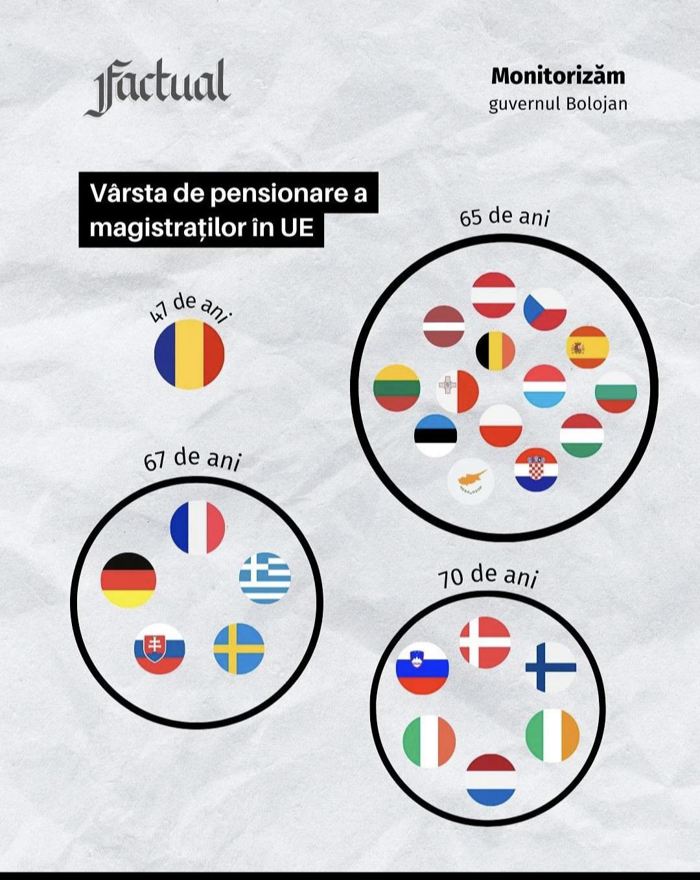
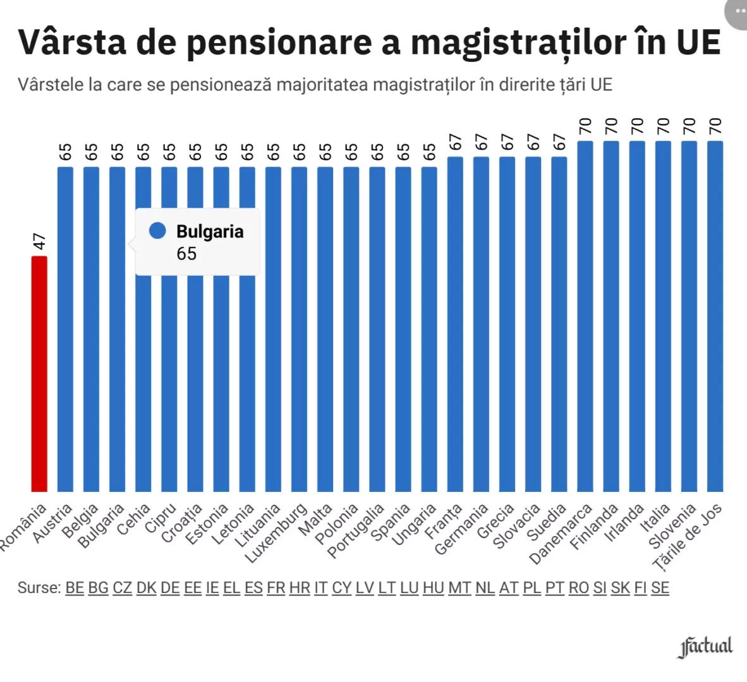
Age of retirement

Slide 12
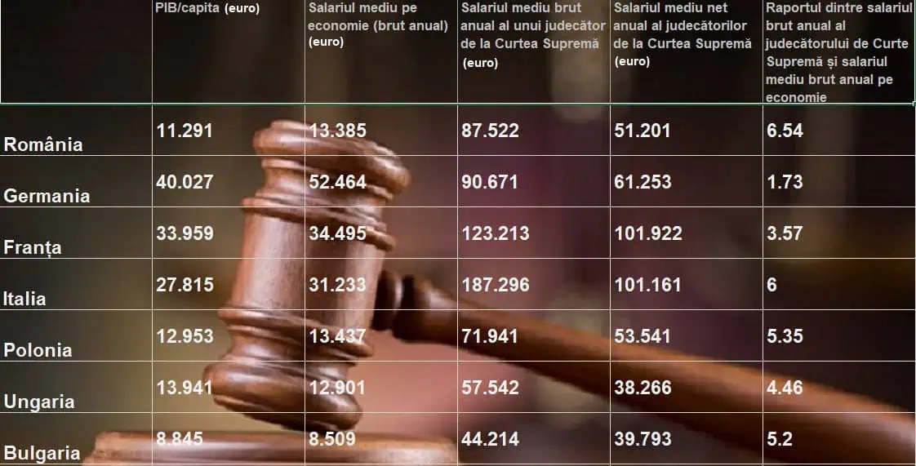
Romanian Magistrates’ Salaries

Slide 13

The problem
The average pension in the justice system reaches 5,000 euros net, much higher than the average pension in Romania, which ranges between 500 and 600 euros.
Due to the formula provided by law, namely that a magistrate's pension should be 80% of the gross income, which means more than the net income, magistrates’ pensions arehigher than salaries
  ”We are in a situation where two-thirds of magistrates in Romania retire at 47-48-49 years old, which is a very young age, an age of professional maturity in any field, and it is a quality issue, a sustainability problem in the coming years because we no longer have people to replace experienced individuals in our public systems who retire too early”
  Ilie Bolojan

Slide 14
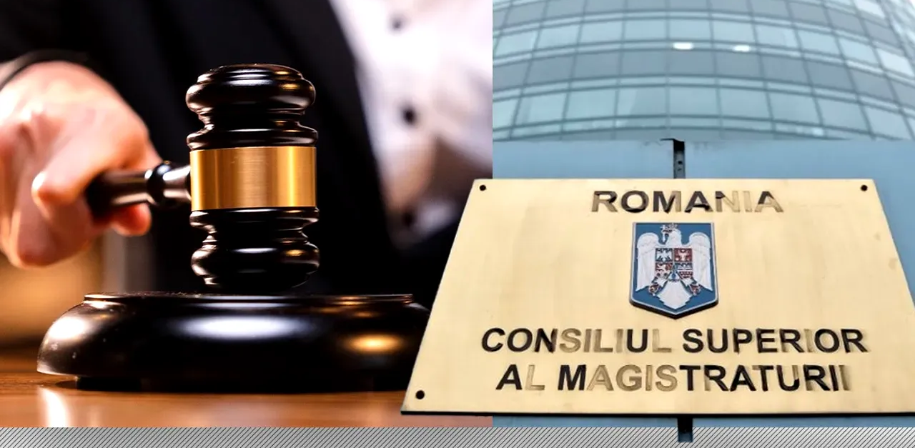
The reforms
Retirement age in the justice system will increase to 65 years old,
The length of service required for magistrates to retire will increase from 25 years to 35 years
Magistrates’ “strikes” (judges, prosecutors, clerks – all levels of jurisdiction)
“Chaos in the justice system”
Different attitude of the civil society as opposed to the first RoL backsliding

Slide 15
Associação Sindical dos Juízes Portugueses
The second subparagraph of Article 19(1) TEU must be interpreted as meaning that the principle of judicial independence does not preclude general salary-reduction measures, such as those at issue in the main proceedings, linked to requirements to eliminate an excessive budget deficit and to an EU financial assistance programme, from being applied to the members of the Tribunal de Contas (Court of Auditors, Portugal).

Slide 16
Additional reading
Raluca Bercea, EU values through constitutional lenses: assessing the resilience of the Romanian Constitutional Court, in Global Jurist, special issue “Resilience of Constitutional Courts” (ed. by Gabor Halmay, Ágnes Kovács and Max Steuer), volume 25 (forthcoming)

